Slide 1
IT as a tool for teaching sustainability
M.Kalneja, 27.09.2022.

Slide 2
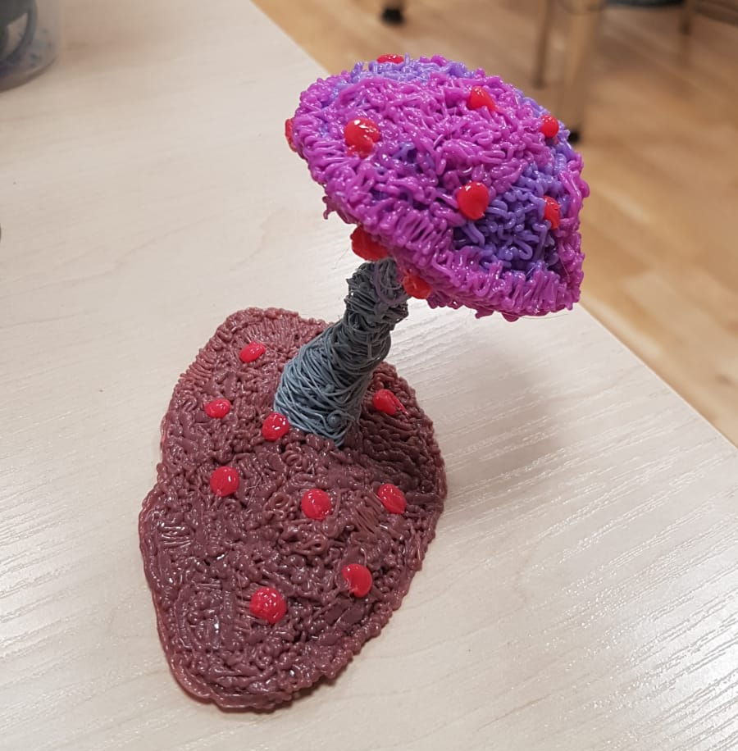
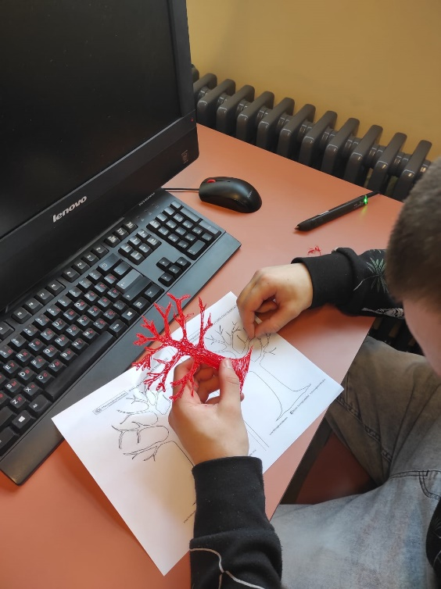
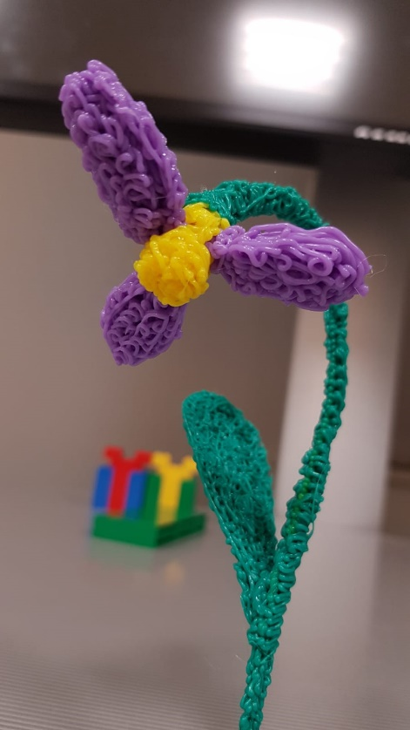
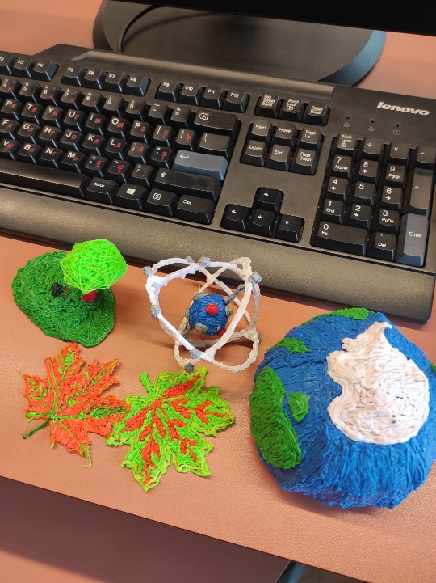
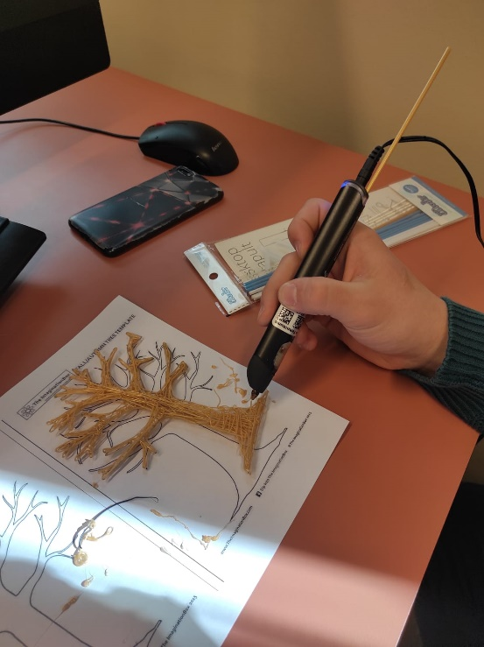
Activities at our school 3D pen

Slide 3
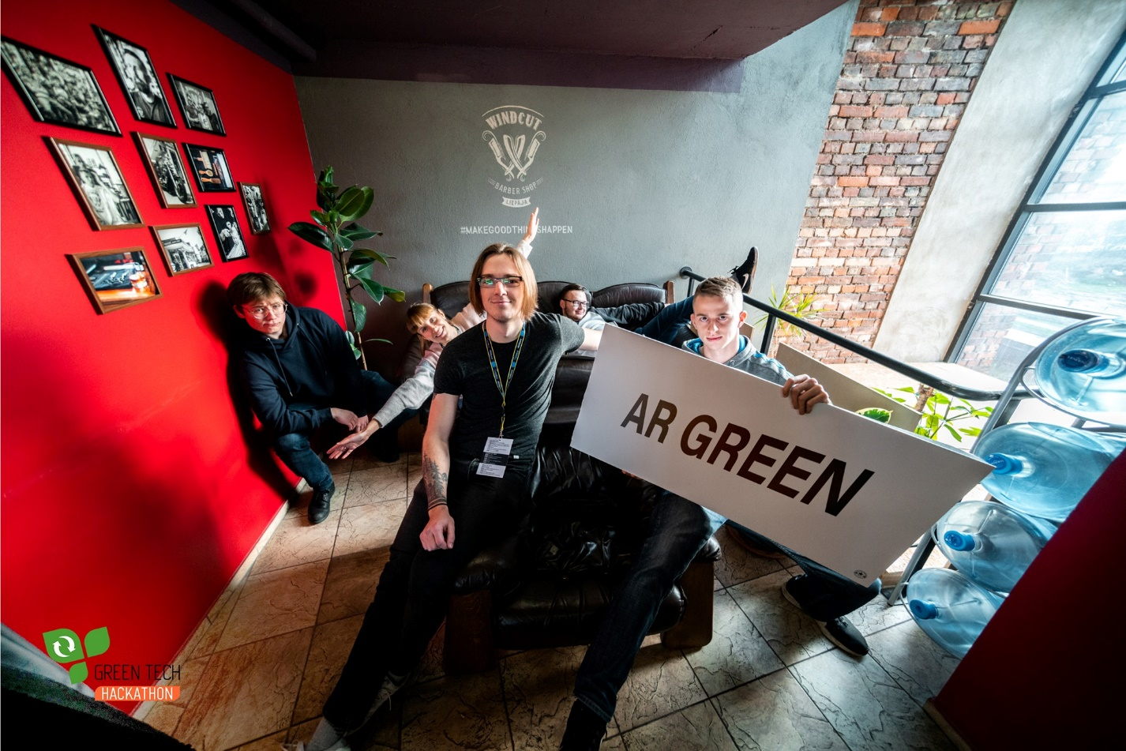
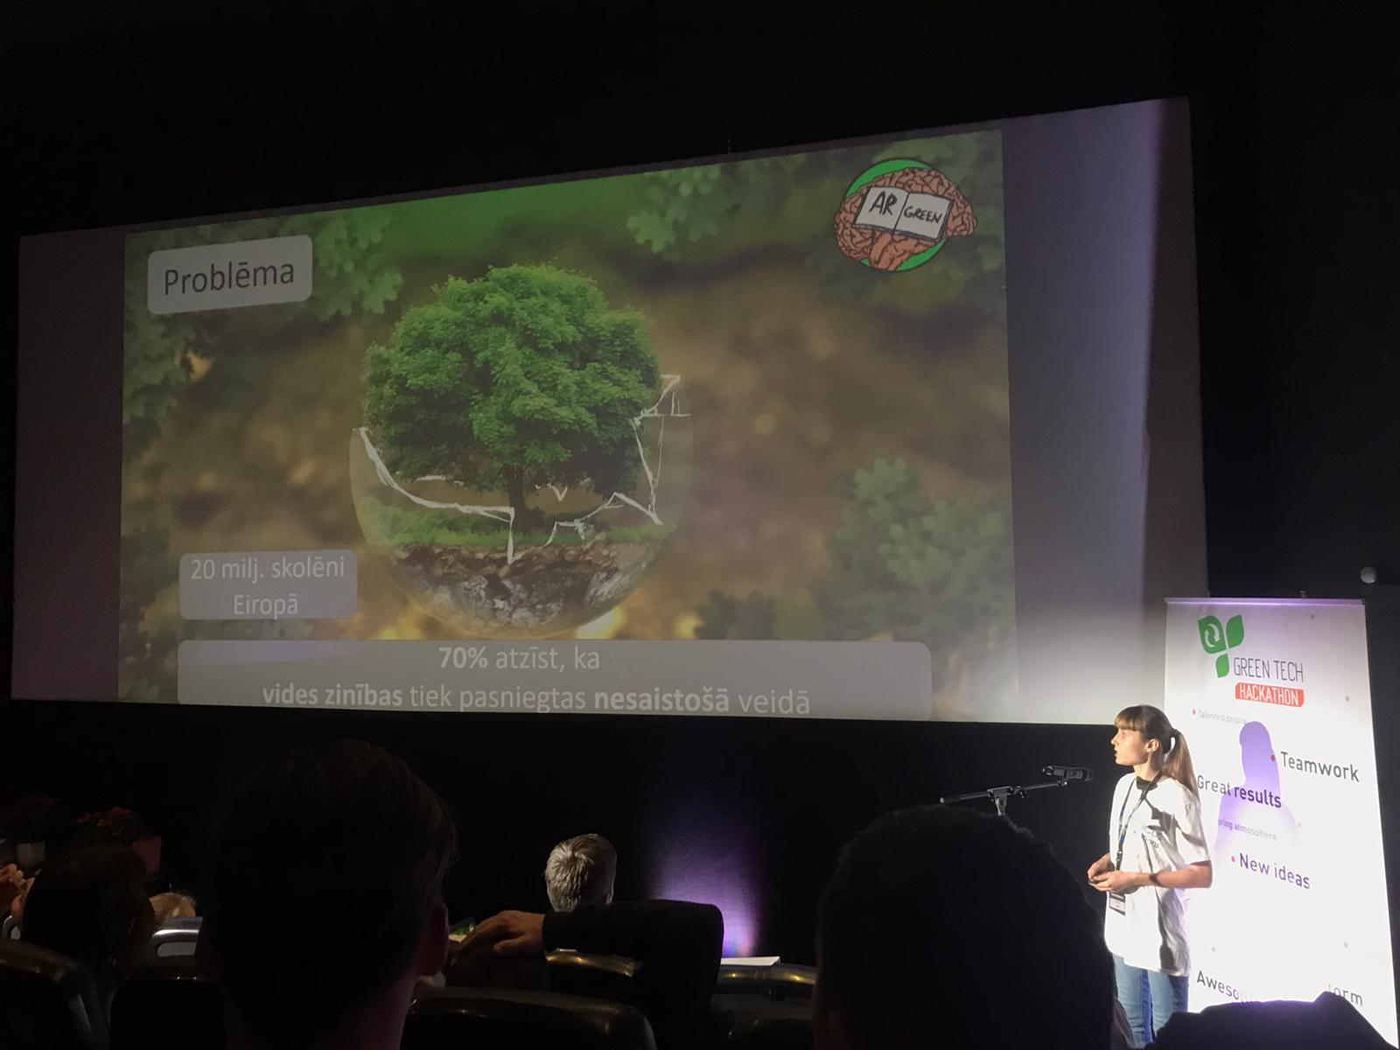
Green Tech Hackathon

Slide 4
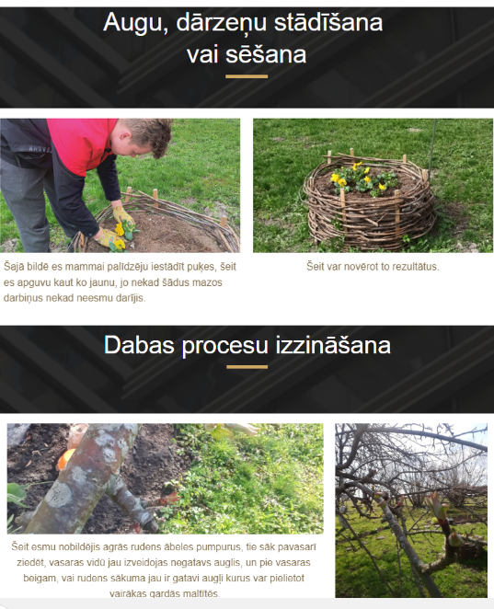
Creating Web page

Slide 5
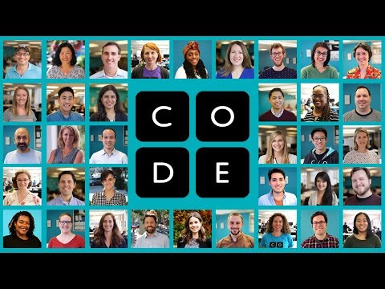
Code.org
Notes:
Code.org is the platform where you can learn about computer science.

Slide 6
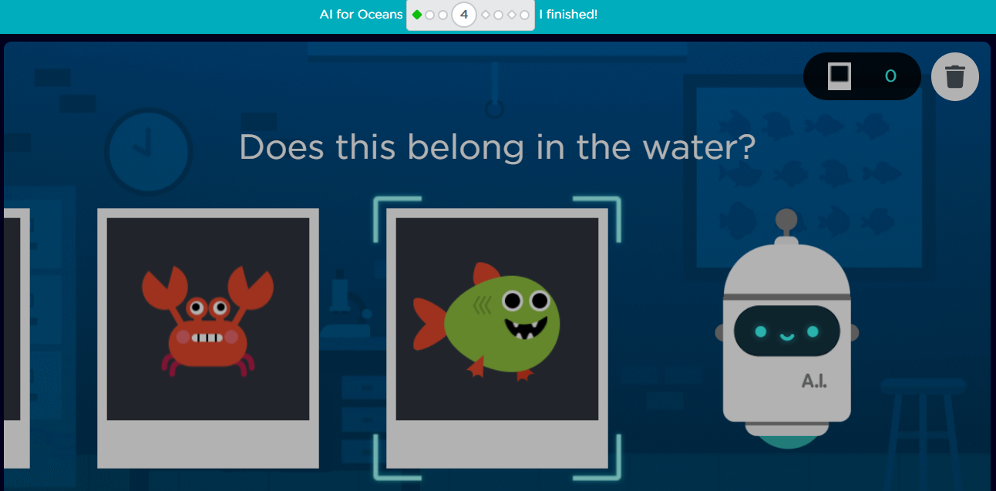
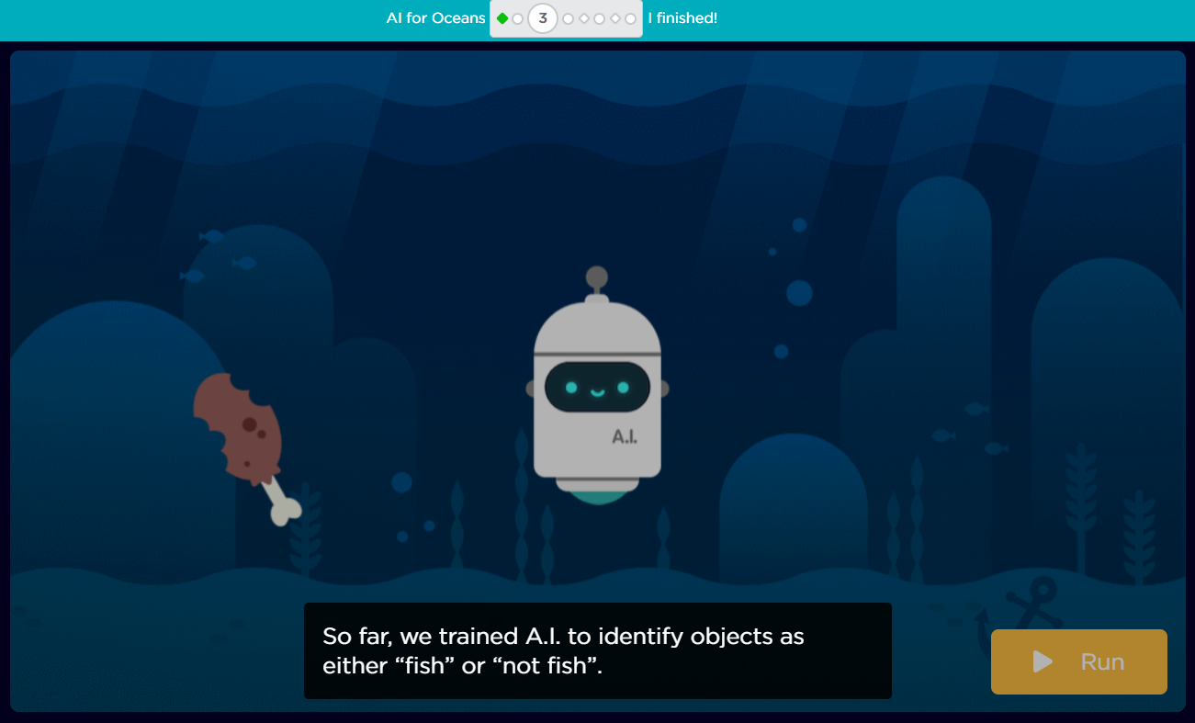
Artificial Intelligence (AI) game I
Learn about artificial intelligence (AI), machine learning, training data, and bias, while exploring ethical issues and how AI can be used to address world problems.

Slide 7
Artificial Intelligence (AI) game II
Garbage dumped in the water affects marine life. In this activity, you will program or train AI to identify fish or trash.
AI for Oceans, available here https://code.org/oceans
Let’s clean up the ocean!

Slide 8
Minecraft Education Edition I
Jump to adventure with game based learning using Minecraft Education Edition.
There are:
Online courses;
Lesson plans;
Full lessons with Minecraft Worlds;
Educator commune.

Slide 9
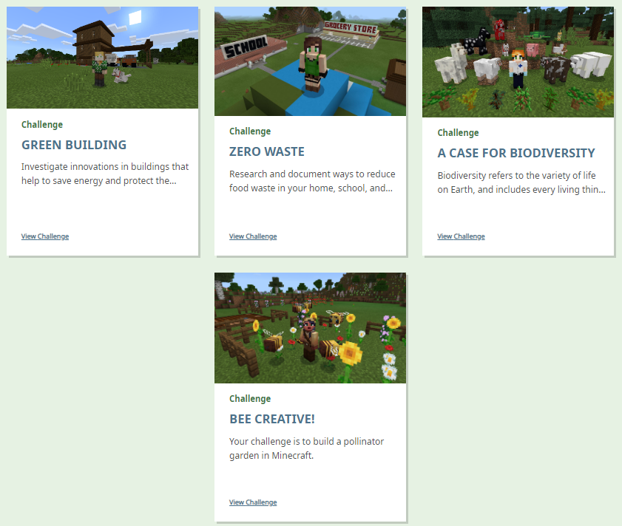
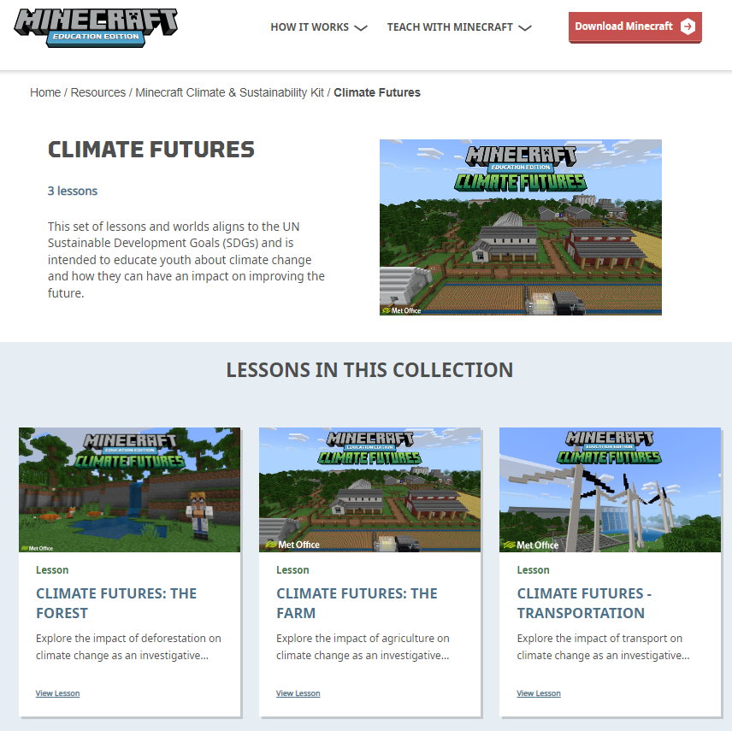
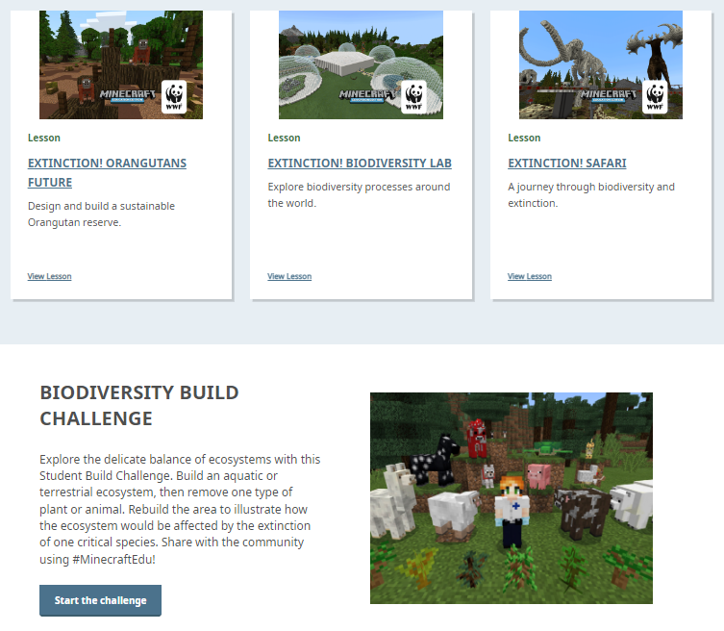
Minecraft Education Edition

Slide 10
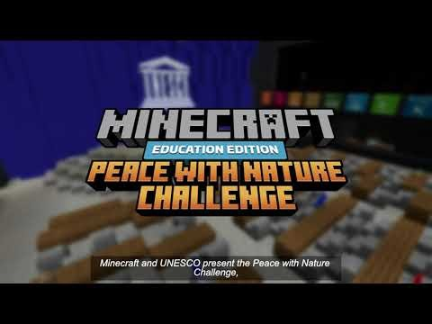
Minecraft Education Edition

Slide 11
Minecraft Education Edition
Use Minecraft Education Edition official web site https://education.minecraft.net/en-us/homepage
Go to https://education.minecraft.net/en-us/get-started/download
Download Minecraft
Find the world and enjoy the game!

Slide 12
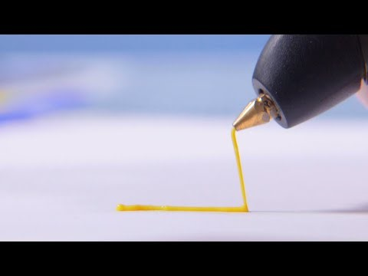
3D pen

Slide 13
3D pen
To develop imagination and design thinking;
Create 2D and 3D design;
You can use 3D printing technology at every topic or issue.
Web page available here https://intl.the3doodler.com/

Slide 14
Work in groups
Create 6 groups:
Minecraft I;
Minecraft II;
AI I;
AI II;
3D pen I;
3D pen II.

Slide 15
Kiitos!
Thank you for your attention!
Tack!
Paldies!

