Slide 1
PSIA «Ventspils labiekārtošanas kombināts»
29.09.2022.

Slide 2
About our company
«Ventspils labiekārtošanas kombināts» is a multidisciplinary company that deals with:
waste management,
greenery works,
road repair and maintenance,
camping services ,
other activities

Slide 3
Waste management
Our company provides several waste management services:
collection of municipal waste and other waste in Ventspils and Ventspils district,
separate collection and sorting of waste,
waste landfill management,
environmental education

Slide 4
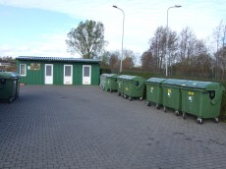
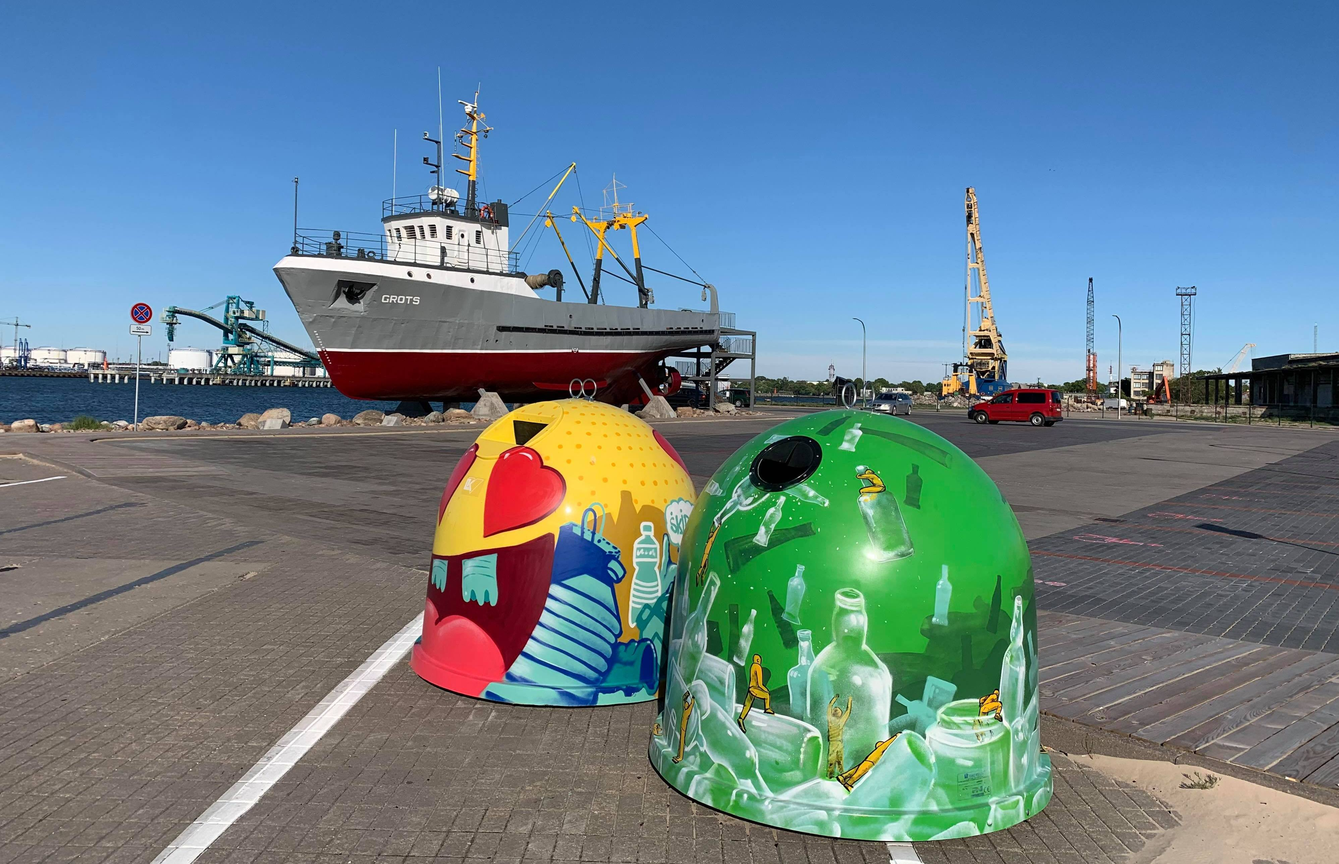
Waste management infrastructure (1)
2 sorted waste collection areas where residents can transfer useful and environmentally harmful waste for further processing
more than 90 separate waste collection points where residents can hand over mixed packaging and glass packaging

Slide 5
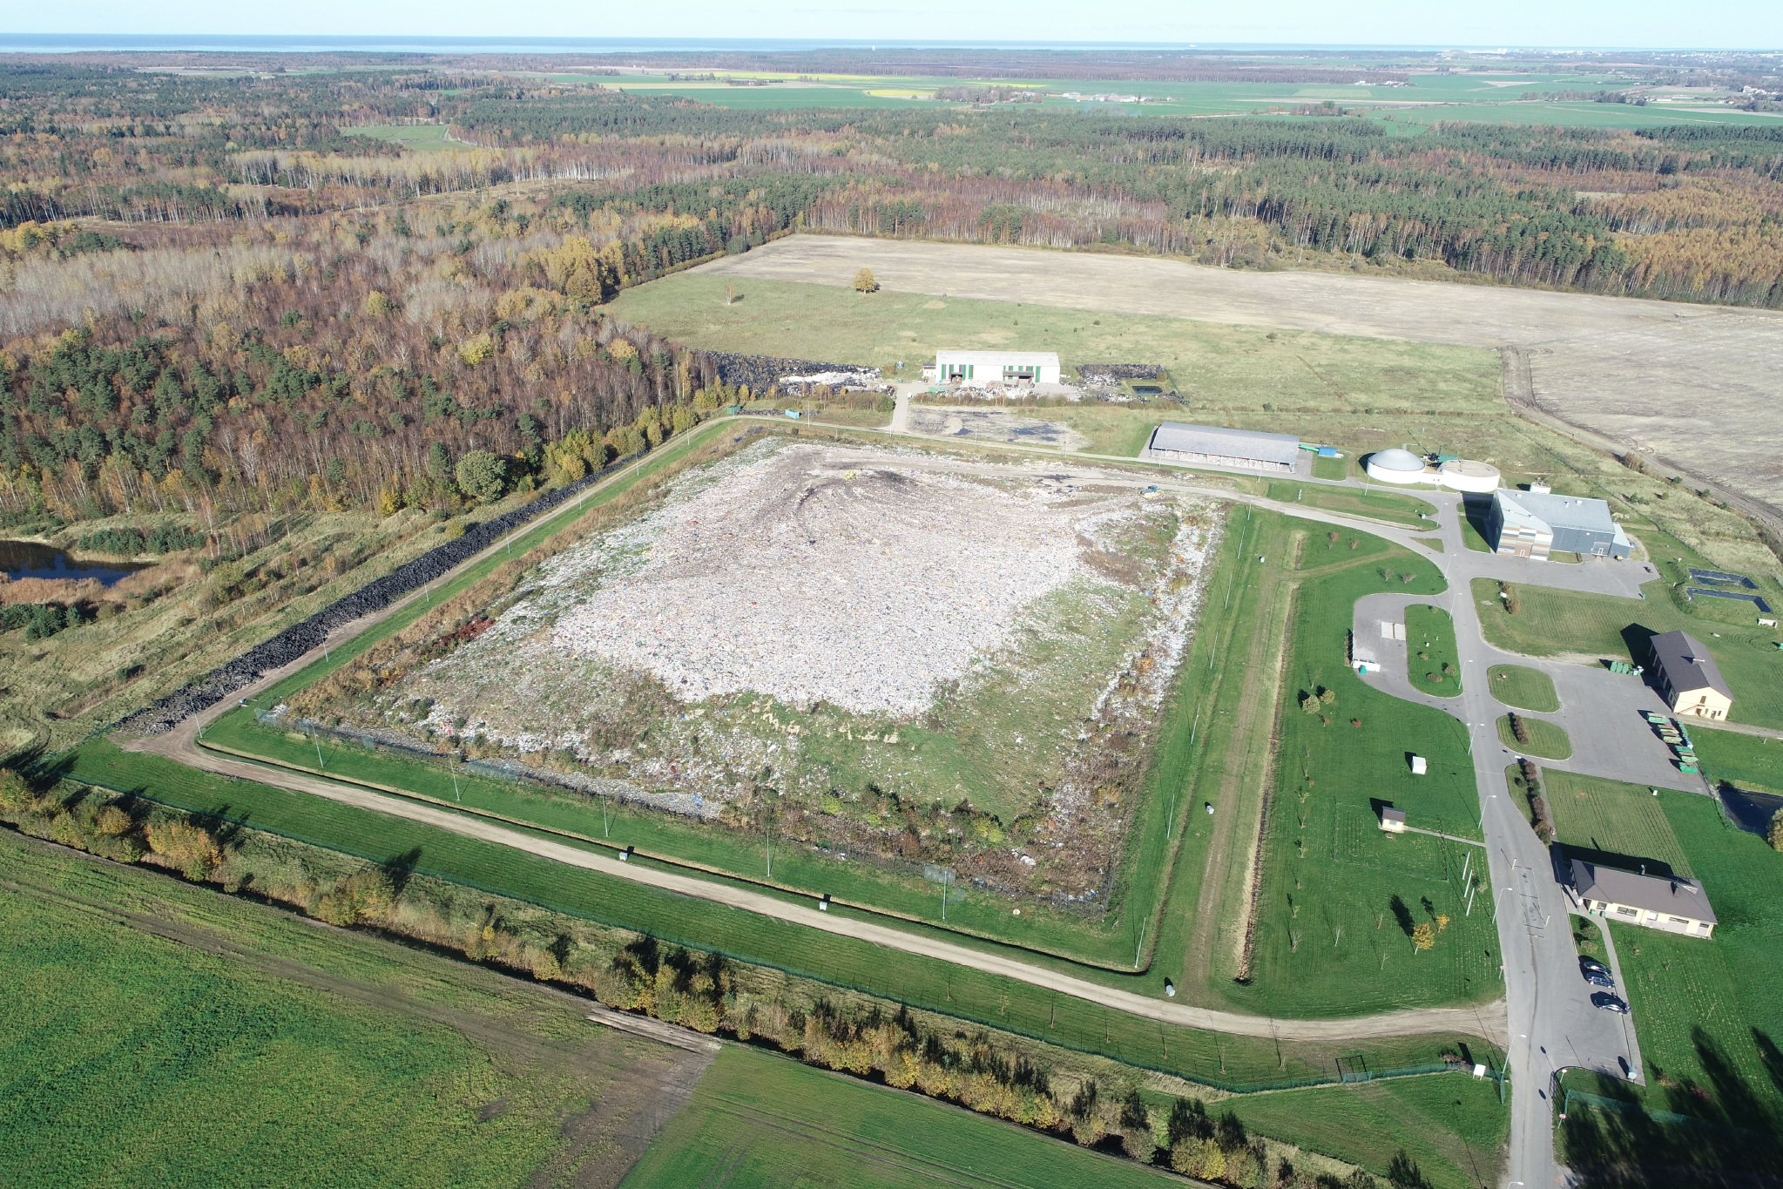
Waste management infrastructure(2)
waste landfill, which accepts waste collected in Ventspils city, Ventspils district and Kuldigas district
the landfill site is 30 hectares
around 65 tonnes of waste arrives at landfill per day
landfill produces biogas and waste fuels (RDF)

Slide 6
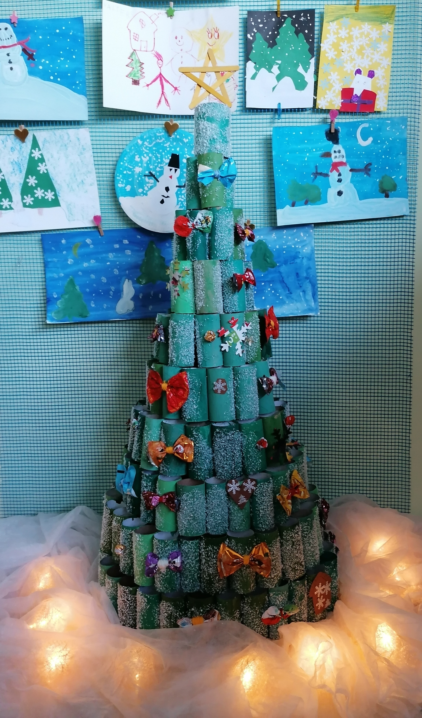
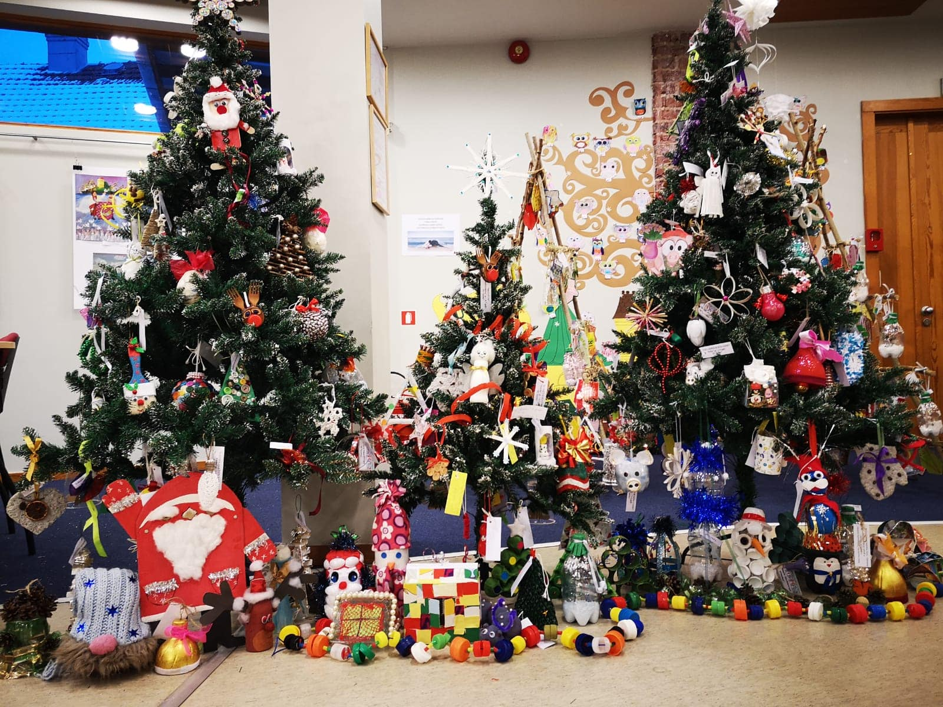
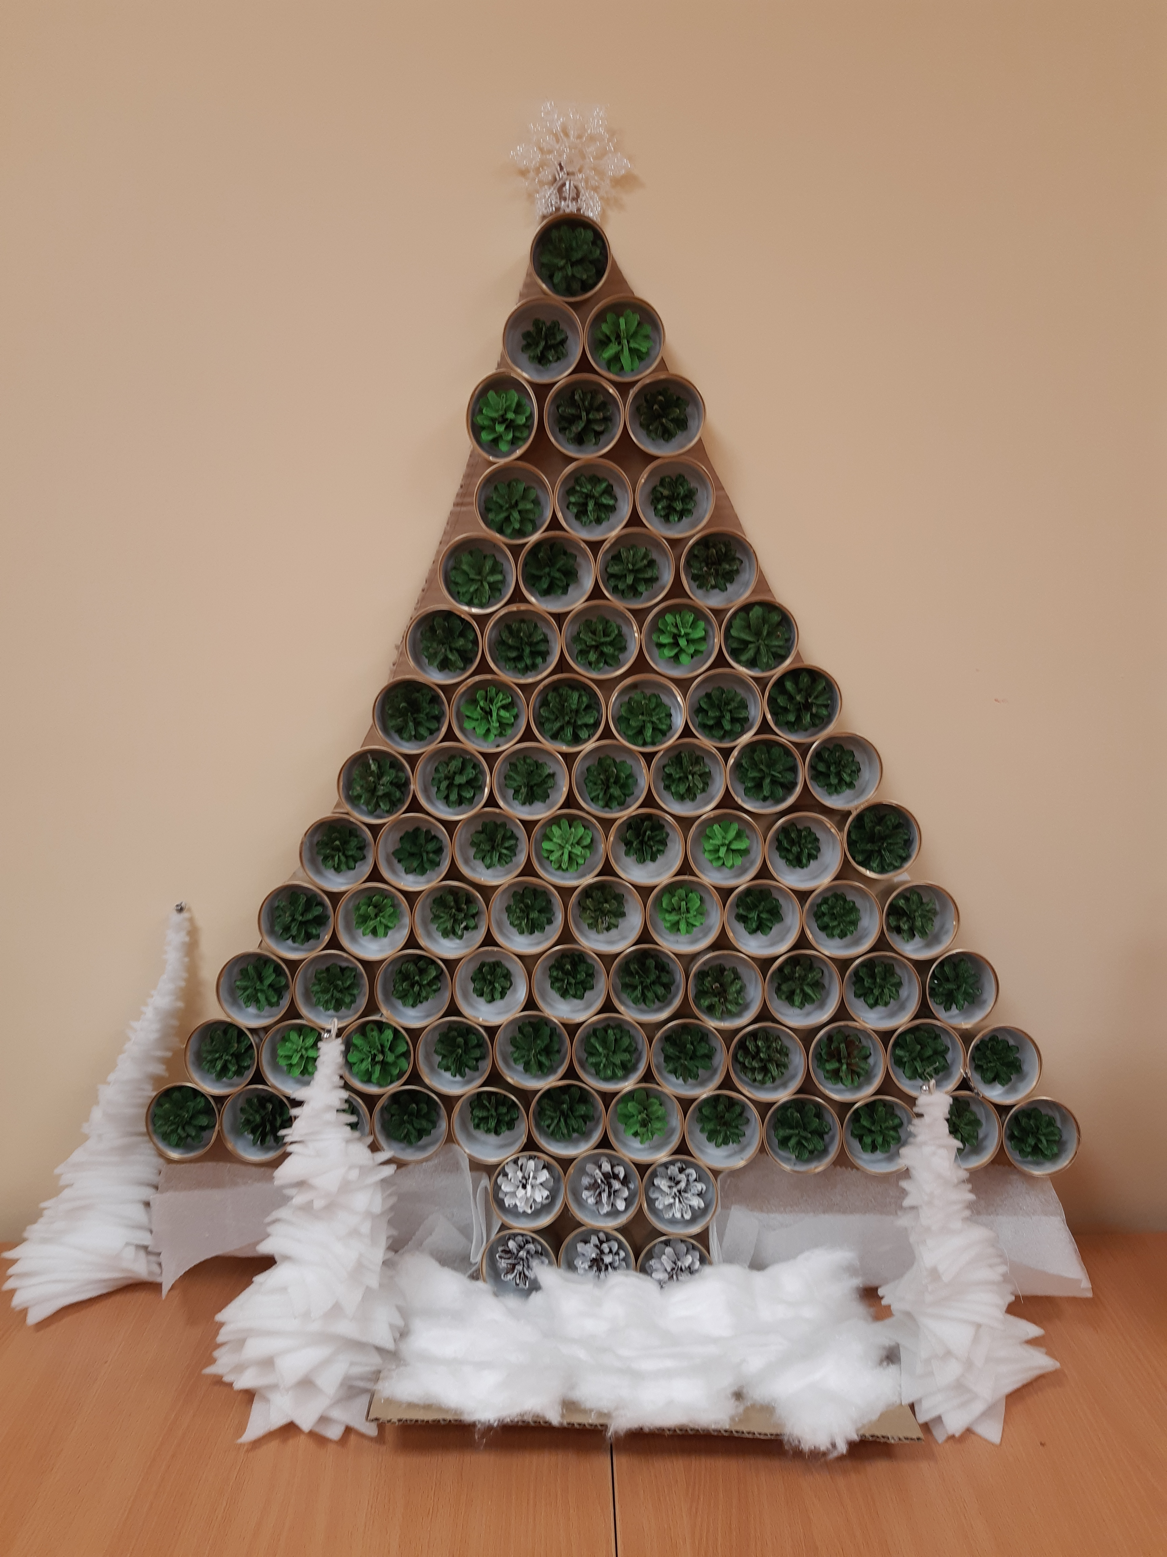
Environmental education (1)
in cooperation with schools and children's gardens, we organise various creative competitions several times a year, visiting schools with lectures or the games we created
Competition - for example, making decorations for Christmas trees from materials already in use

Slide 7
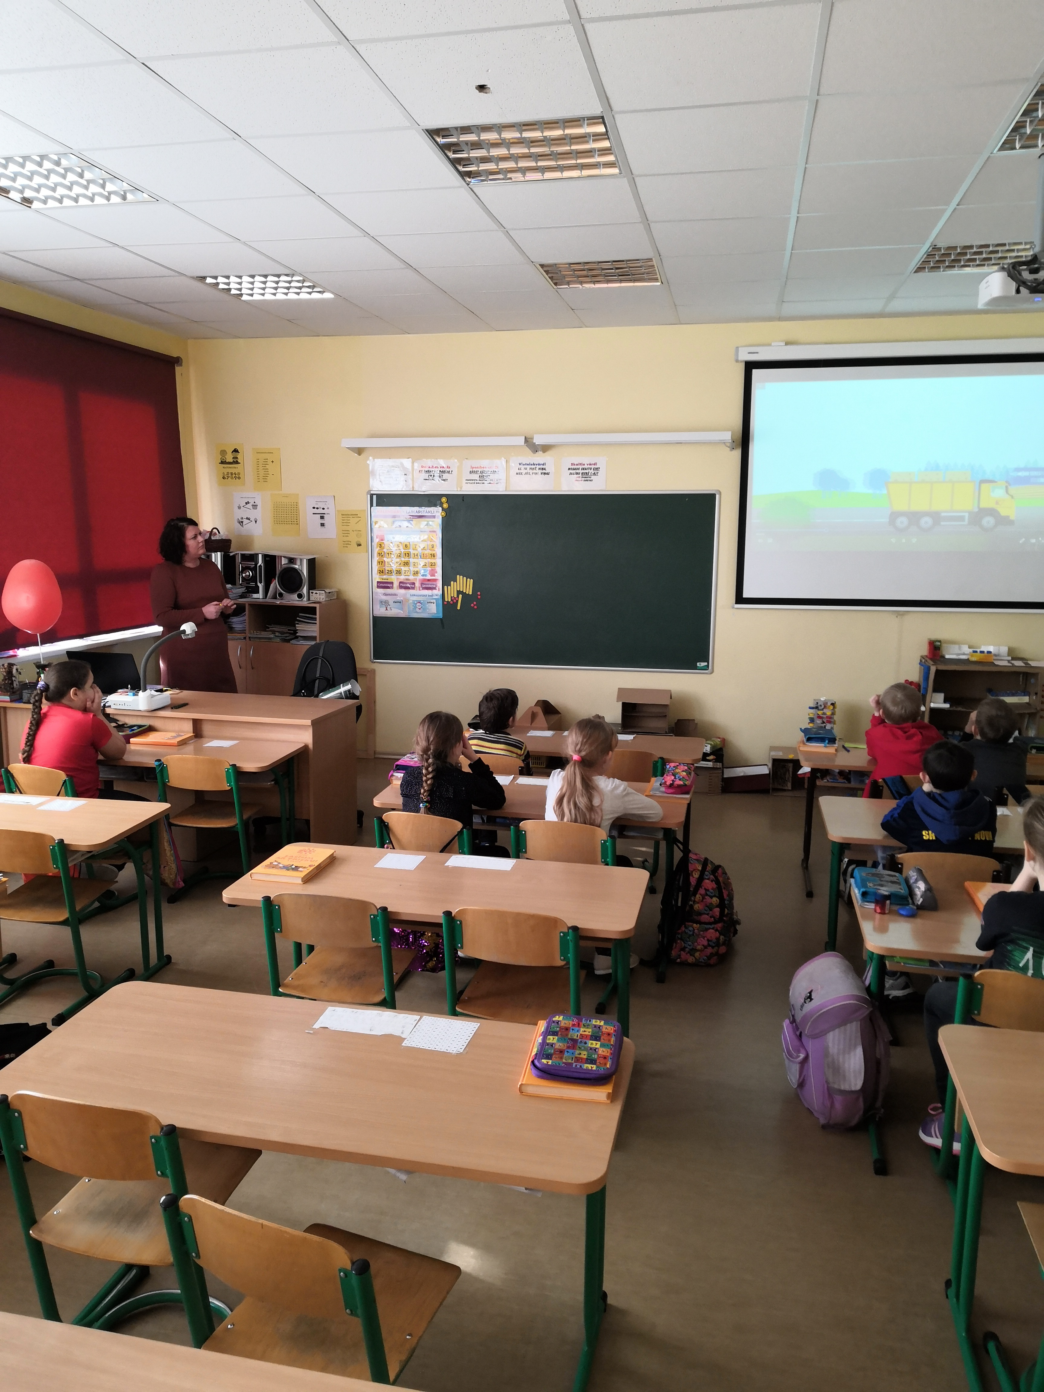
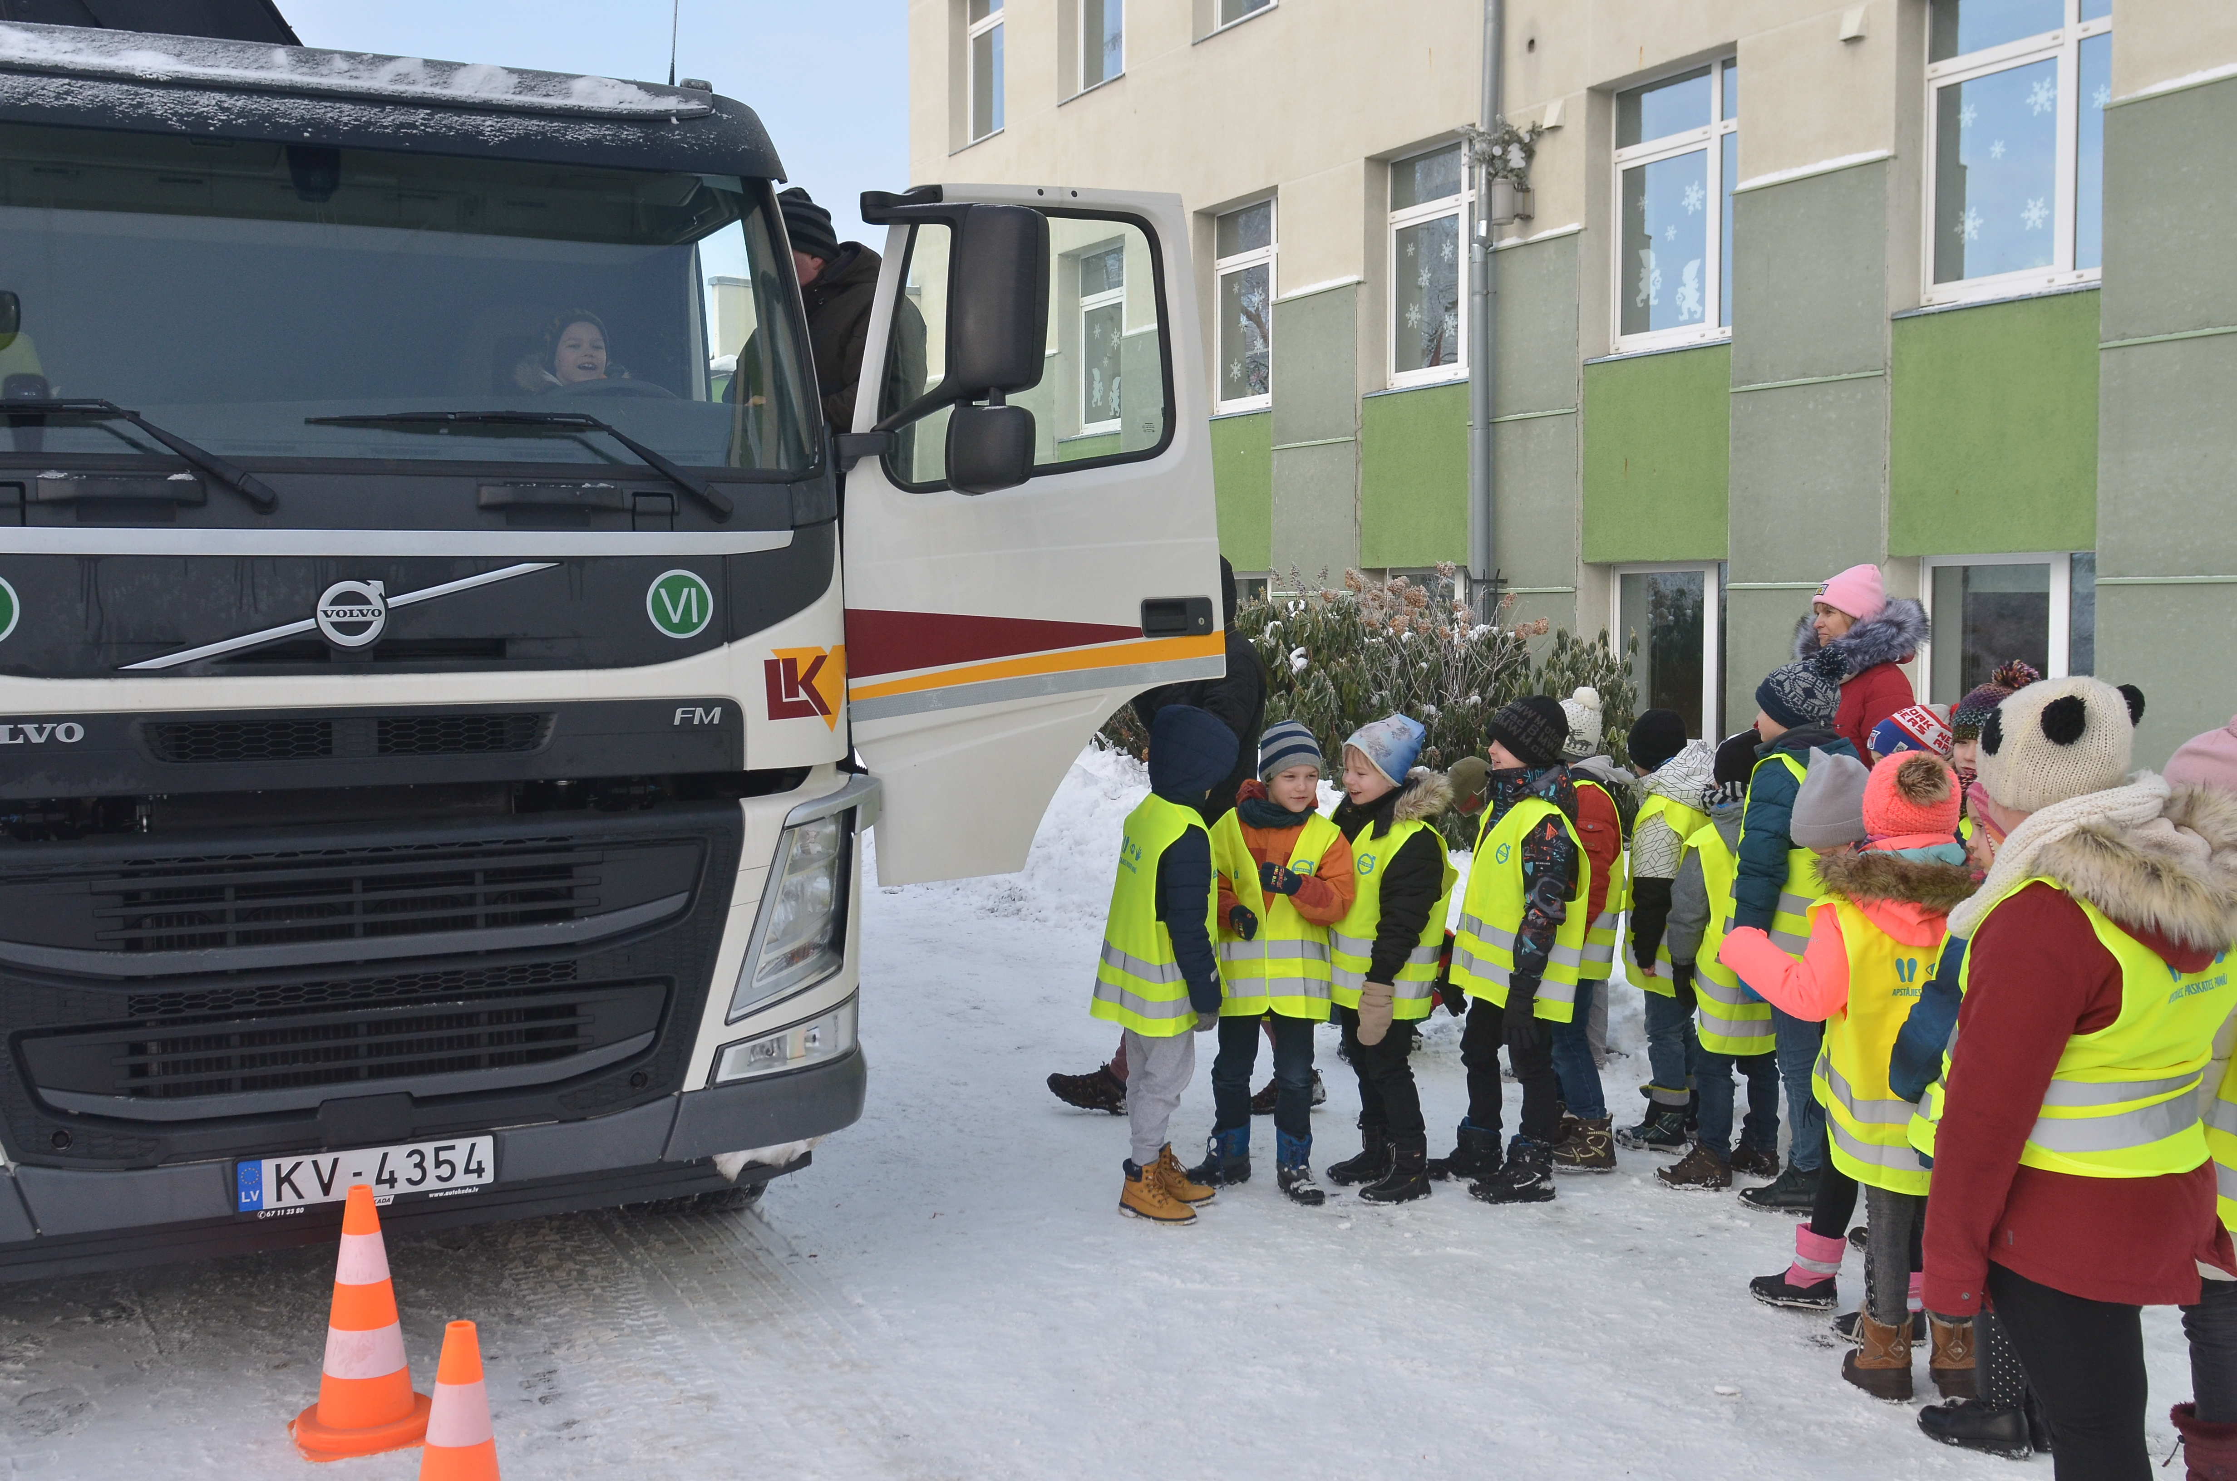
Environmental education (2)
Lectures - for example, we visit schools with lectures on waste management and let children get to know the waste collection process more closely

Slide 8
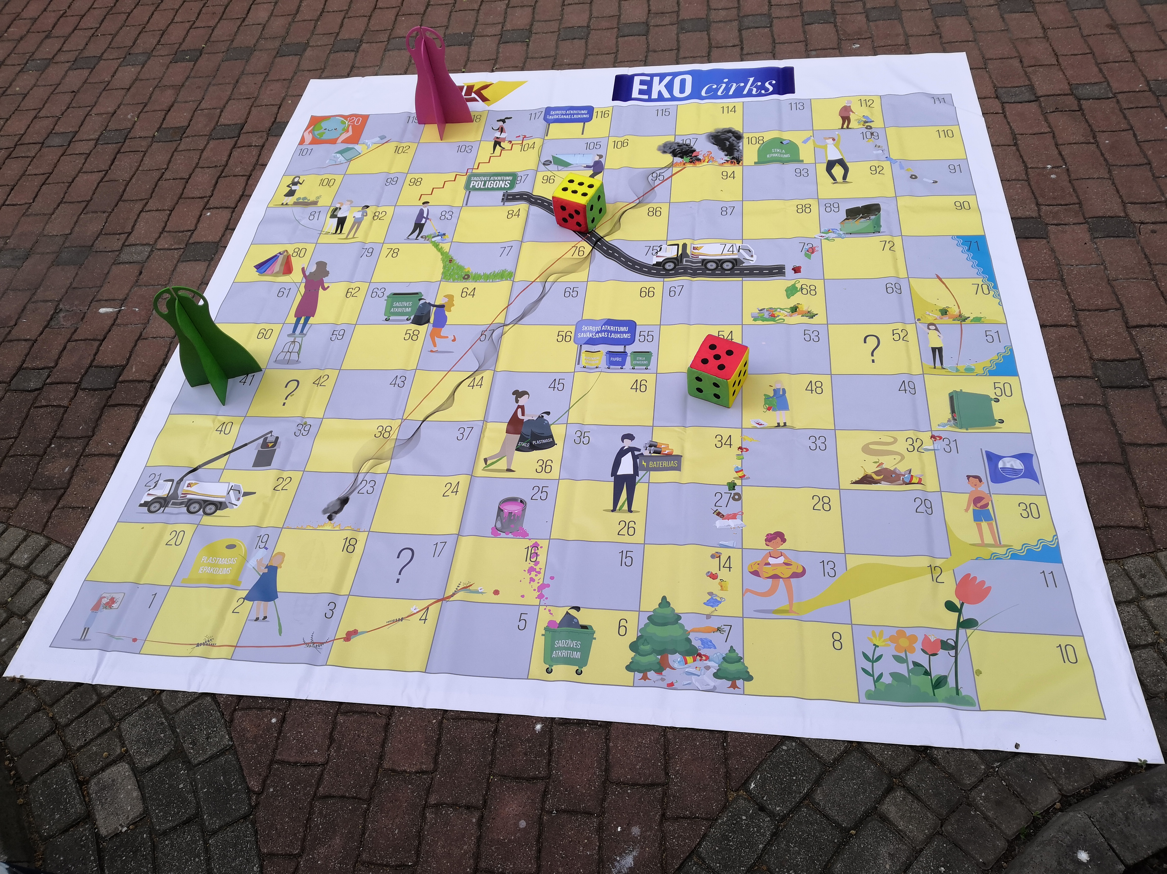
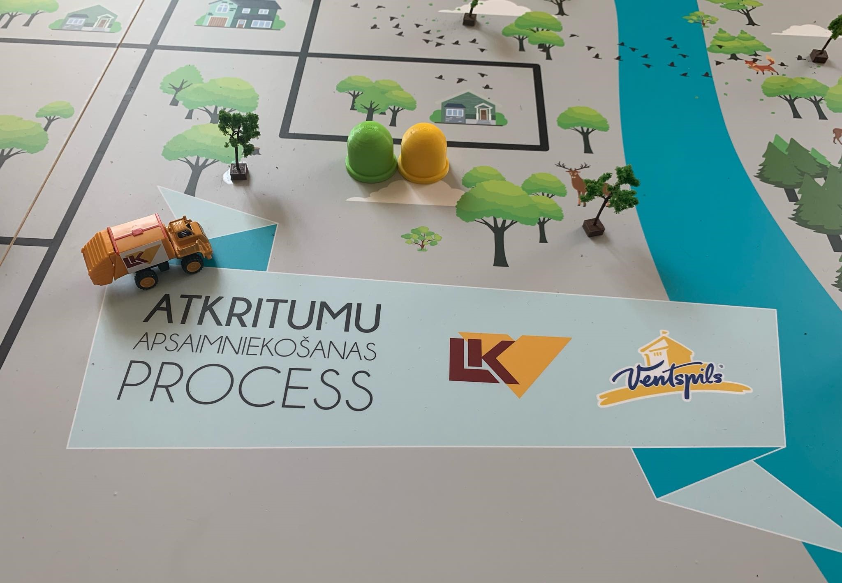
Environmental education (3)
Games – for example, we've created floor game to explain waste management processes to children in a more perceptible way

Slide 9
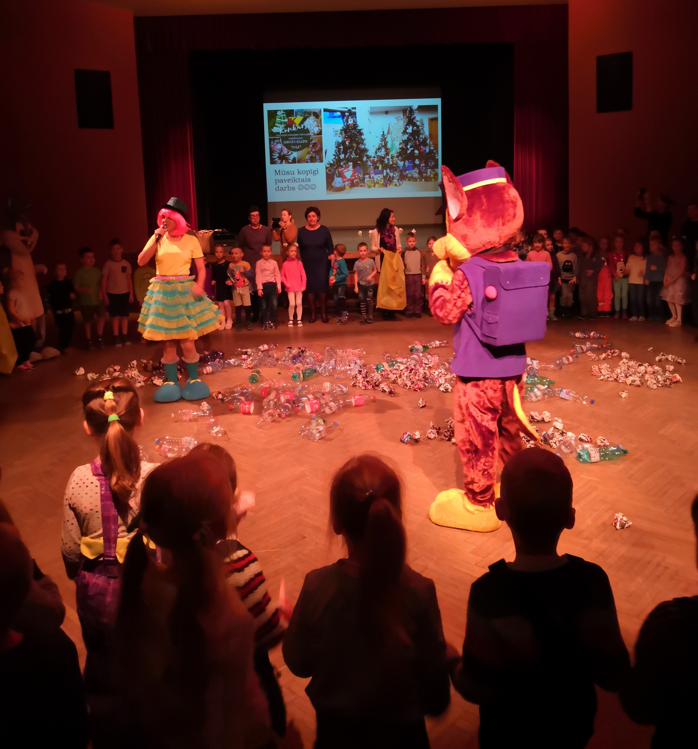
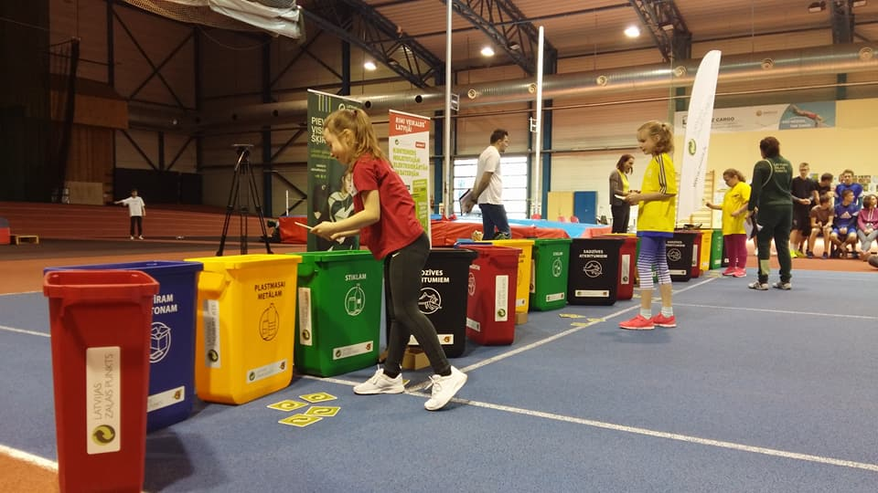
Environmental education (4)
Organisation of events – for example, relating to the sorting of waste

Slide 10
Thank you for your attention!

