Slide 1
GLO-VET - making vocational education promote
global responsibility and
sustainable actions
Learning Teaching and Training week 26-30 of September, 2022 in Latvia, Ventspils
Ieva Krūmiņa, Ventspils Tehnikums, project coordinator

Slide 2
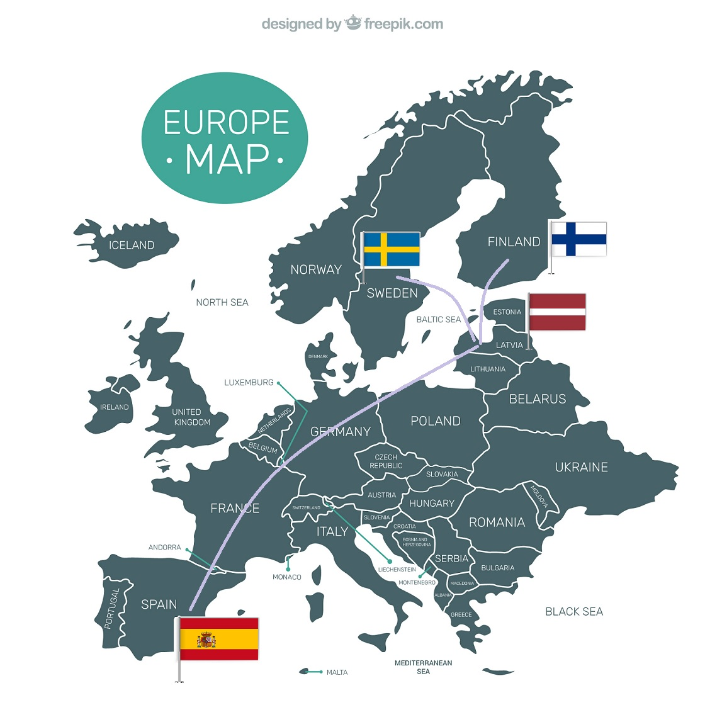
Welcome!
Programme of the week
Day 1: Sustainability & city
Our city, experience and activities
Excursion at Concert Hall of Latvia (energy efficient building)
IT as a tool for teaching sustainability
A visit to Ventspils Reiss (passenger carrier)
Guided excursion in Ventspils
Day 2: Nature & excursion day
Staldzene Beach
“Pure chocolate Museum” and workshop
Eko Household “Gaiķi’’
Kuldīga - is one of the most charming and magical towns in Latvia
Day 3: Taking action
Local organizations (VLK & Ūdeka)
Debates
Affordable energy training
Sustainable Cities and Communities
Eco art workshop

Slide 3
Briefly about the project
Erasmus+ partnership project, exchange of good practices (1.9.2020- 30.06.2023)
Support and training for teachers on United Nations Sustainable Development Goals (UN SDGs)
Opportunities for vocational students to learn and act for sustainability with their peers in other countries
Expected results:
Improved competences in applying UN SDGs
6-11 in everyday life, and in the vocational profession of students
Improved key competences (21st century skills): entrepreneurial mindset, social, civic, intercultural and language competences, critical thinking and other

Slide 4
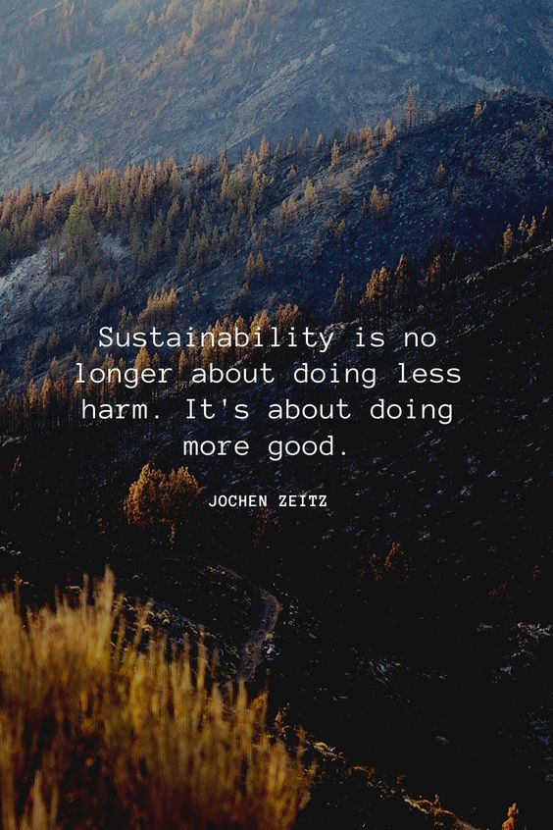
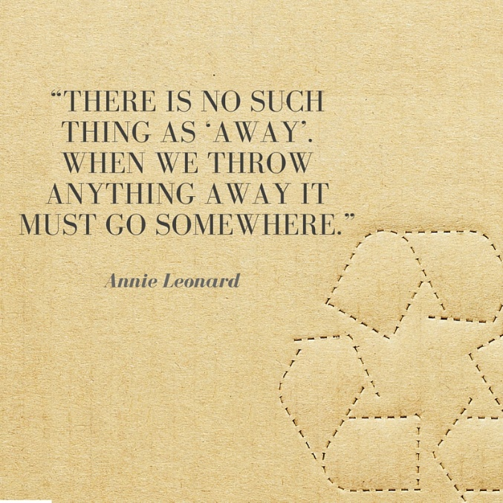
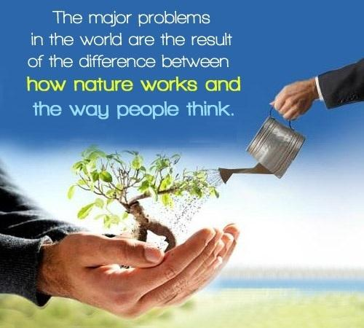
Ice breaking questions:
Your name and who are you?
What’s your hobby?

Slide 5
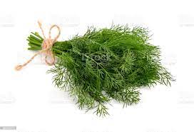
Latvian language intro Try to translate to English
Good afternoon!
Thank you!
Good bye! (formal)
Hi!
Think greener!
Labdien!
Paldies!
Uz redzēšanos!
Čau!
Domā zaļāk!
Some strange Latvian letters: č, š, ķ, ļ, ģ, ņ, ā, ū, ī, ē, ž

Slide 6
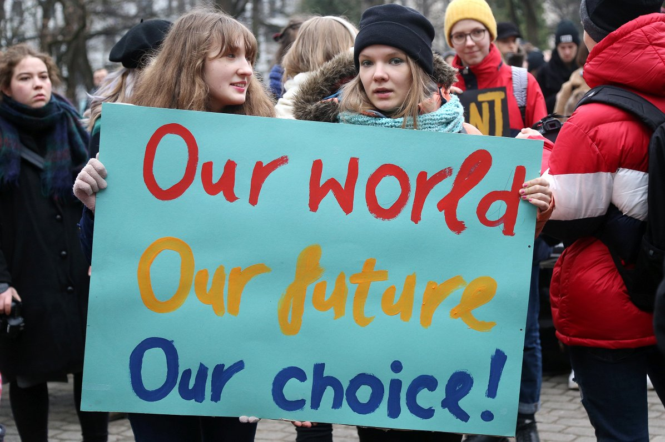
Ventspils Tehnikums GLO-VET activities so far (1)
1) Survey about SDGs – example -> Do you address (give attention to) the SDGs actively in your teaching? Answers NO
“Although in teaching subjects accidently I include them, this is not done by purpose, because I am primarily guided by the topics included in the curriculum.”
“Not enough is known about it.”
“Lack of time. Not enough information.”
“There is not enough time for that at the moment.”
“I am not aware of SDGs and have not paid attention so far.”
“No information, not questioned about this, no offer, only self-understanding”

Slide 7
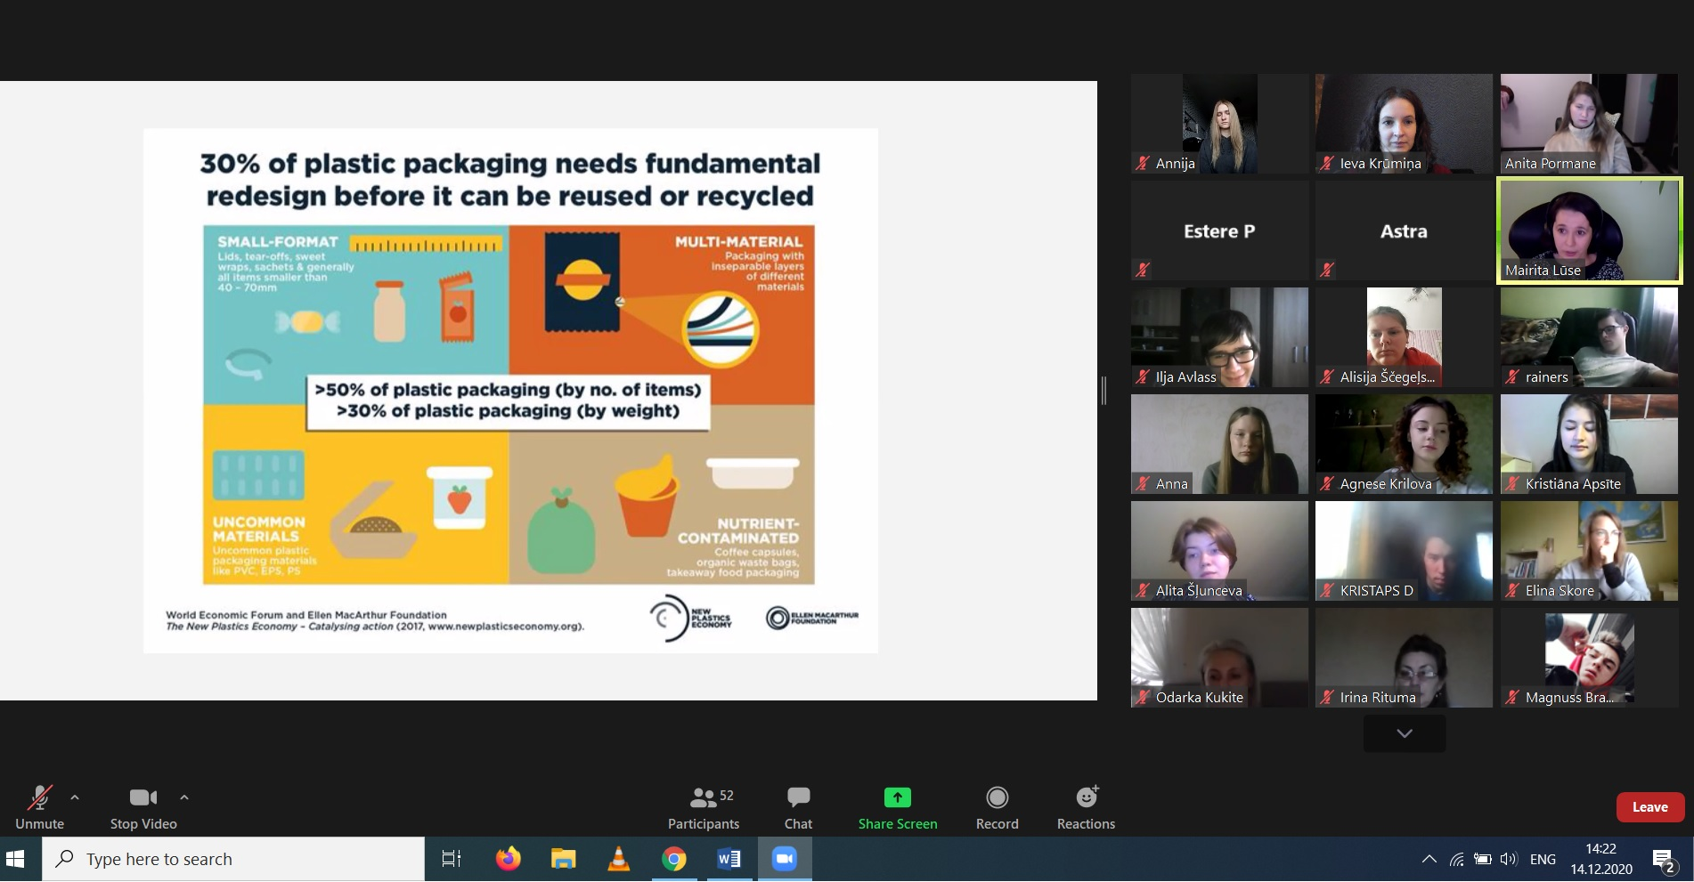
Ventspils Tehnikums GLO-VET activities so far (2)
2) Webinars organized about environmental topics

Slide 8
3) “Unmasking T-shirts”
5 trainings during 5 months (63-75 participants)

Slide 9
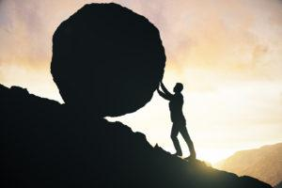
4) Changes in school’s development strategy
Developing green strategy:
Getting to know / visiting companies that implement sustainability-related activities
Improving international cooperation opportunities in the field of environment and attracting investments
Inclusion of sustainable development goals in the learning process
Compliance with green procurement procedures
Organizing webinars and guest lectures for professionals in the field

Slide 10
Actions
Green skills week (competition “How to be environmentally friendly”)
Waste sorting (delivery of office paper, batteries, catering food packaging)
Development of a virtual reality game on environmental issues
Development of study materials for actualization of environmental issues
Plant and book exchange activity (the event takes place every year in June)

Slide 11
5) Contest «My home, my city and my planet»
Aim | The aim of the contest is to update the most important modern problems - sustainable development and climate change, as well as to promote and be able to take care of preserving the climate of our city and planet and ensuring sustainable environmental development.
Participants | Pupils, students, kindergartens and cizitens of Ventspils
Period | 14.February – 1.March 2022
Description | Contest: Topic of contest– preservation and sustainability of the environmental climate. Works are done individually or in grups: 2.1. In groups (max 25 pers.) – a game “For greener Ventspils”. 2.2. Individually – works out a gift or decoration“For greener Ventspils” The work has to include: 70% recycled materials or resouces of nature (stones, sands etc.) Pictures have to be send to official email, max 5 pics and the work has to be seen clearly. Document added – the application form.
Prizes | Green thinking format. Decision – services: Tickets to Ventspils Amusement Park and cinema tickets.

Slide 12
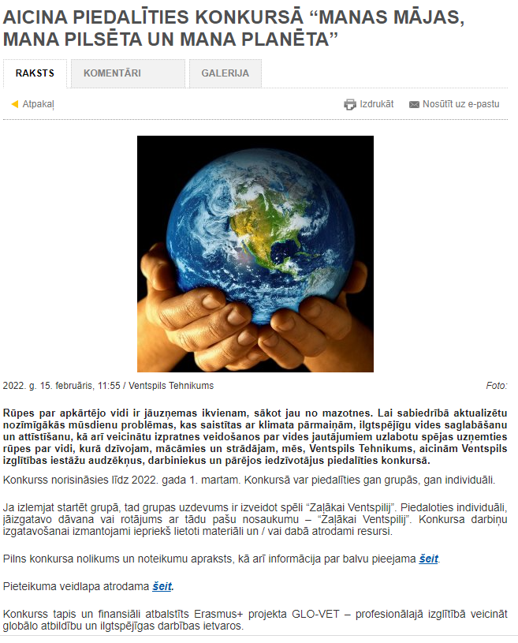

Slide 13
APPLICATIONS

Slide 14
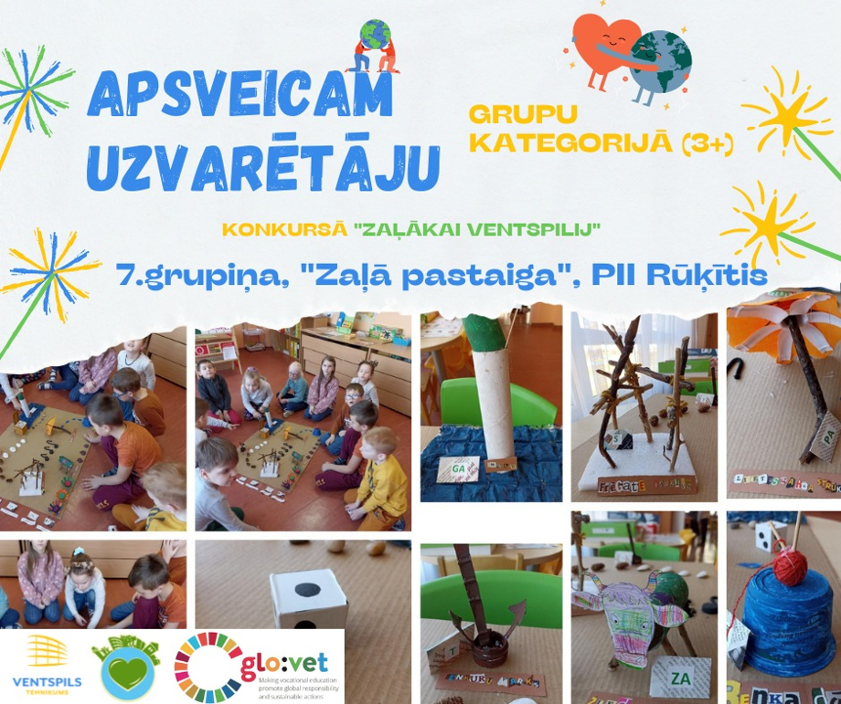
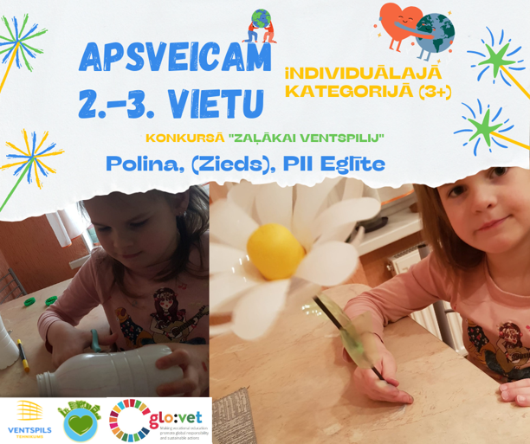
AWARDING!

Slide 15
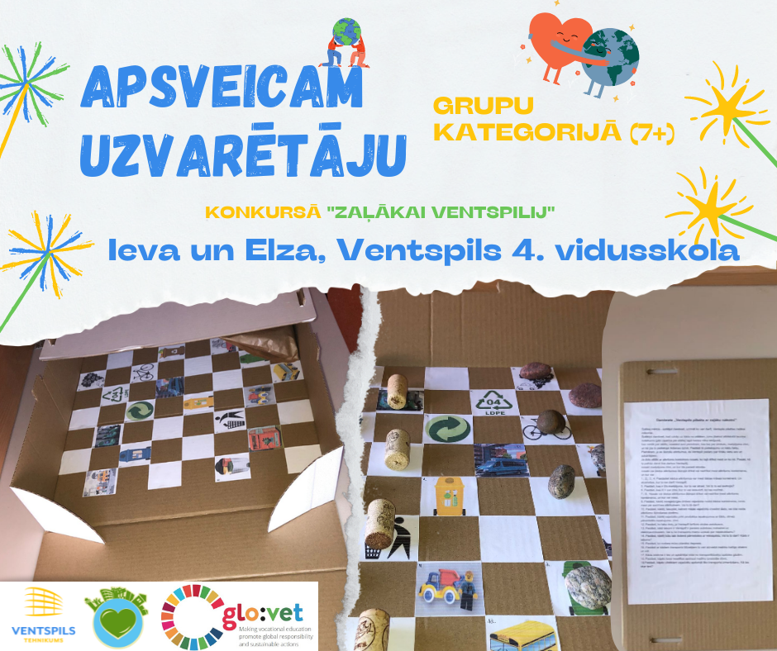
The aim of the game is to learn what you can do for a greener future of Ventspils by playing checkers.
Explain why the clothes should be placed in specific containers and not thrown away with household waste. Do you do that?
Tell us what are the benefits of changing regular buses to electric buses in Ventspils. Do you consider this modal shift necessary?
Explain why it would be good to ride a bicycle on a daily basis. Do you do that?What is the benefit?

Slide 16
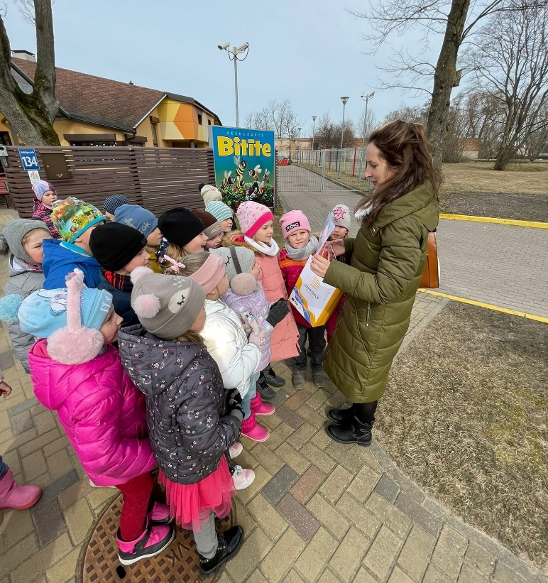
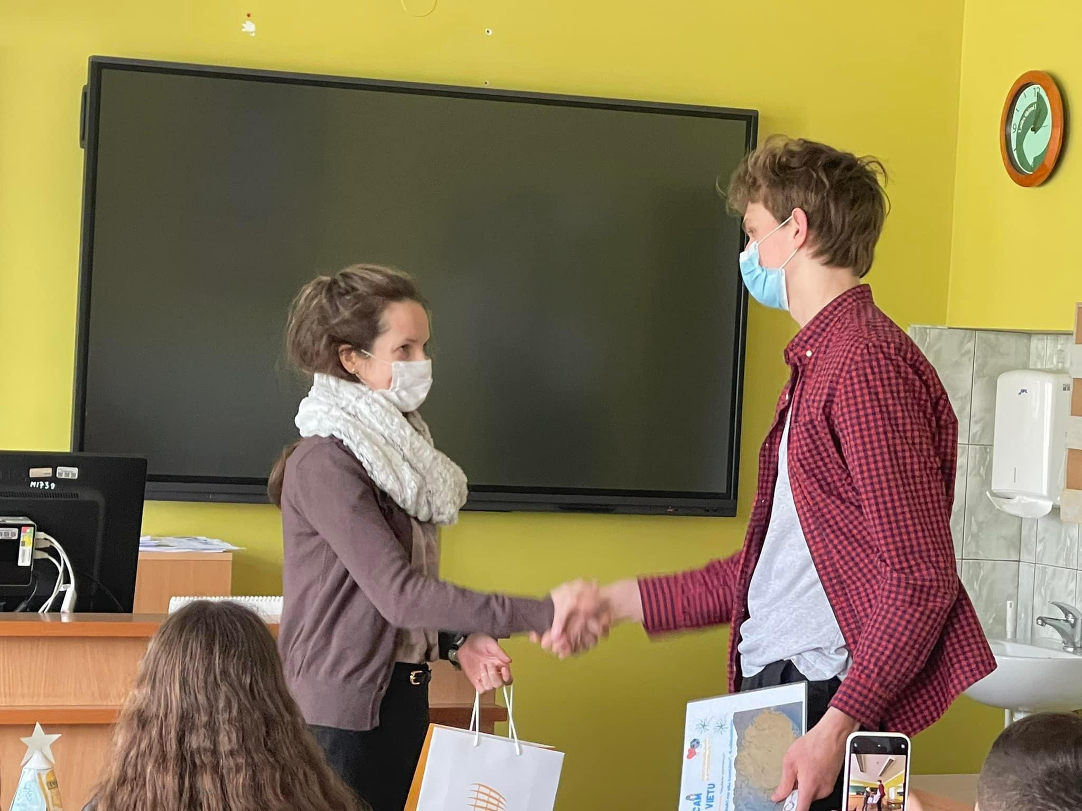
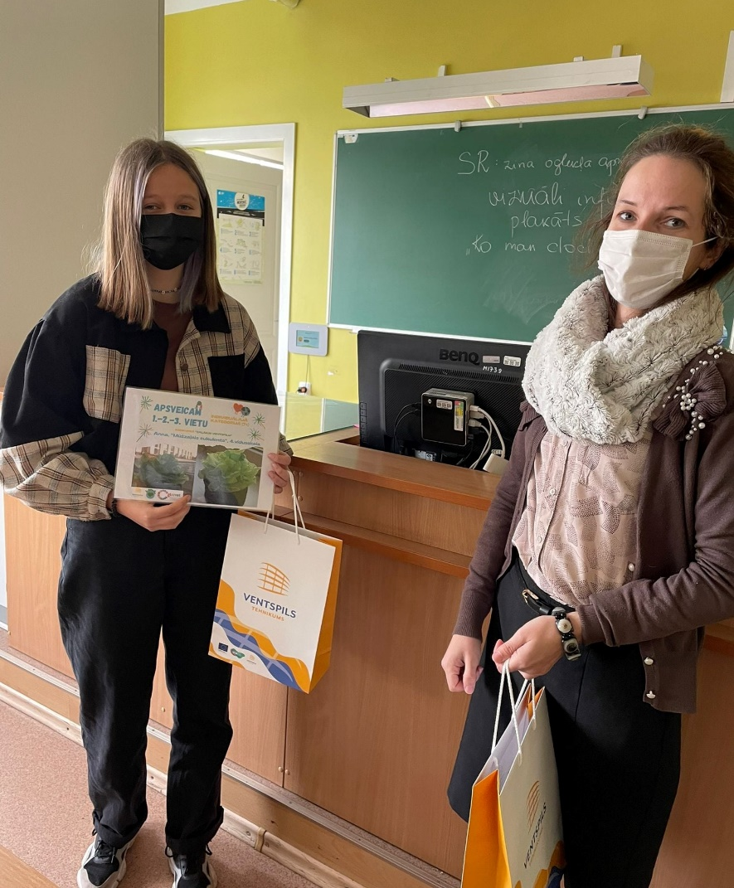
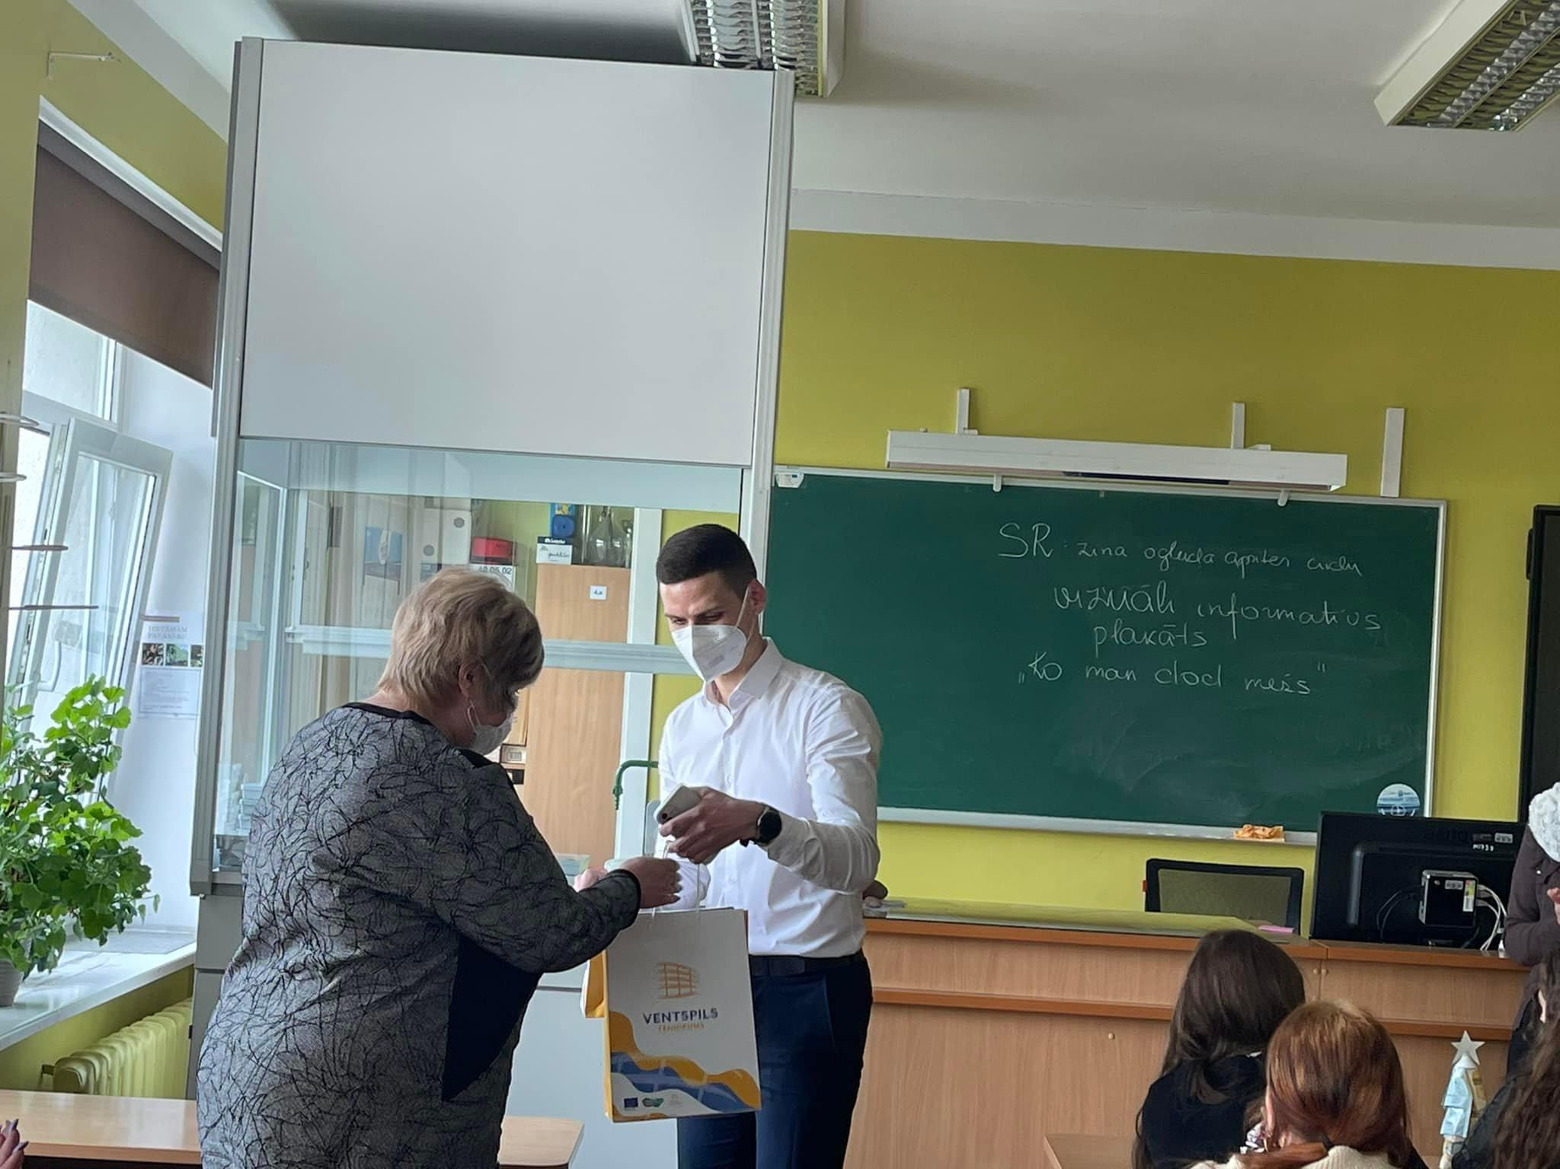
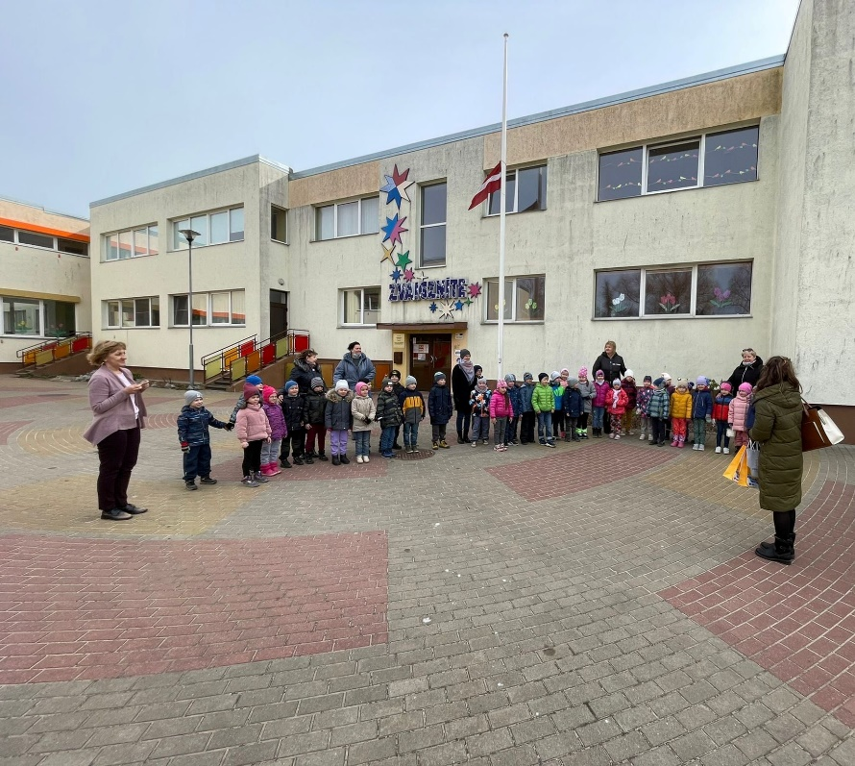
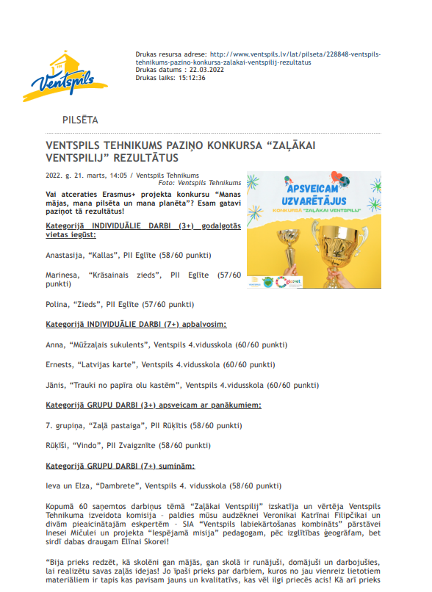
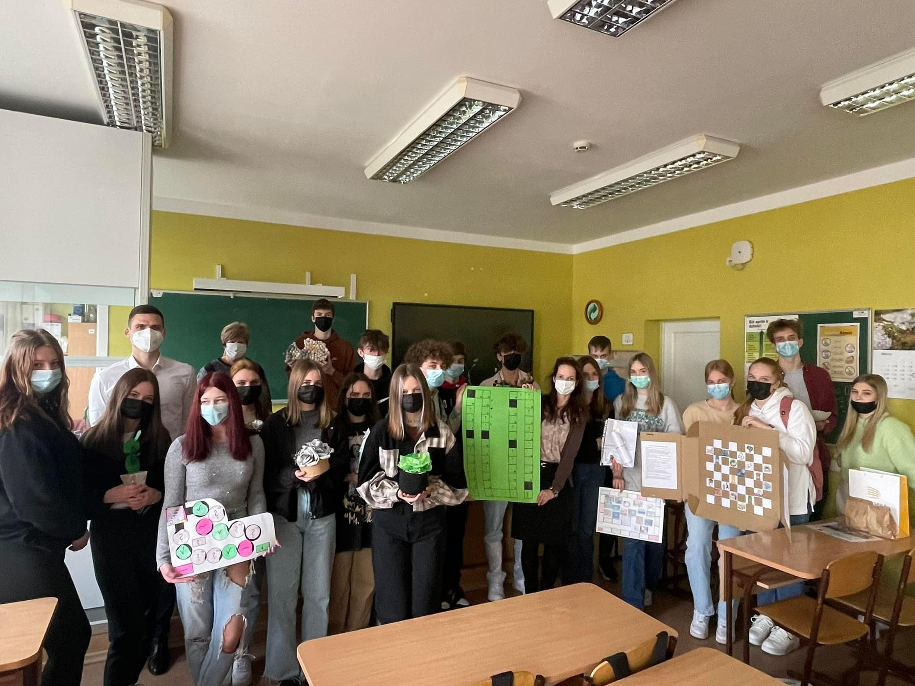
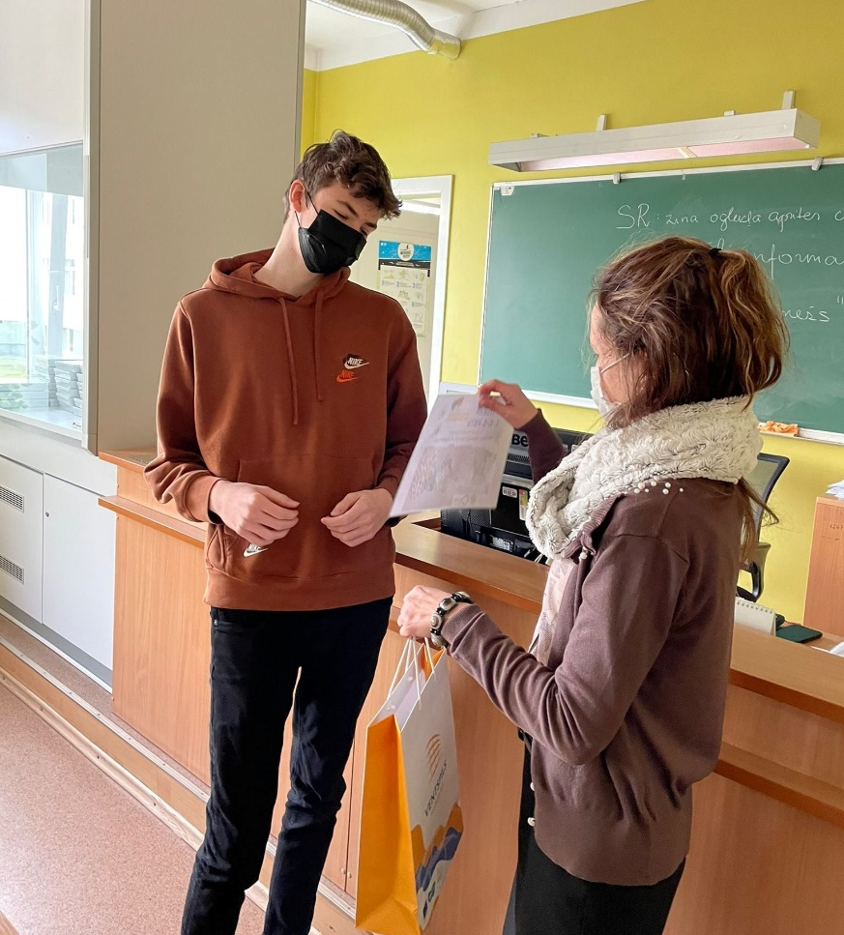
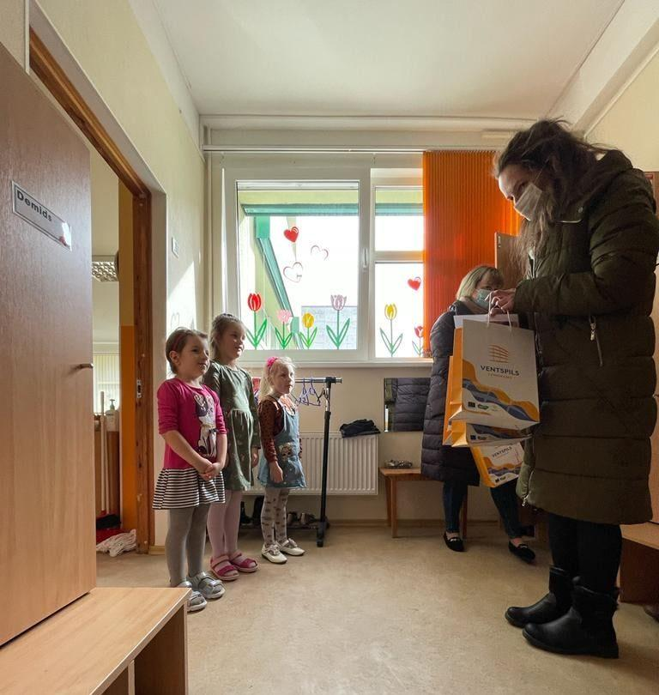
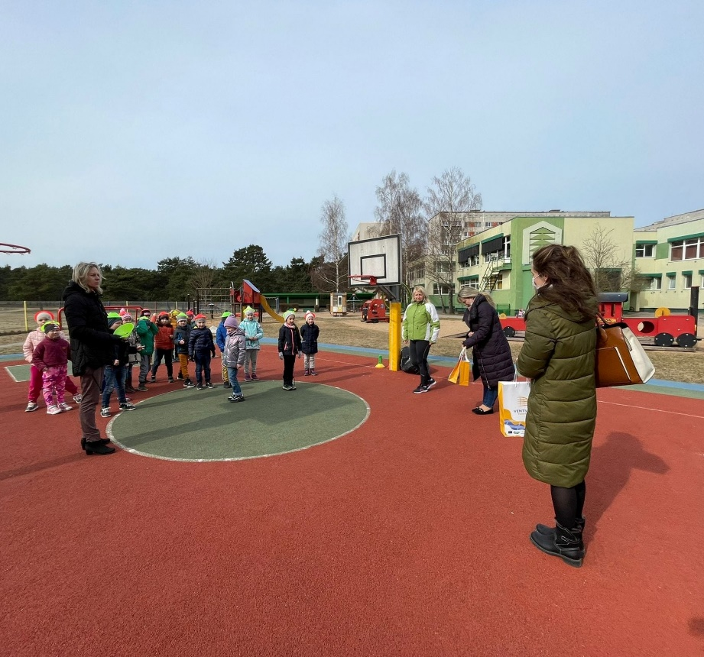
Publication in local municipality webpage and award ceremony ☺

Slide 17
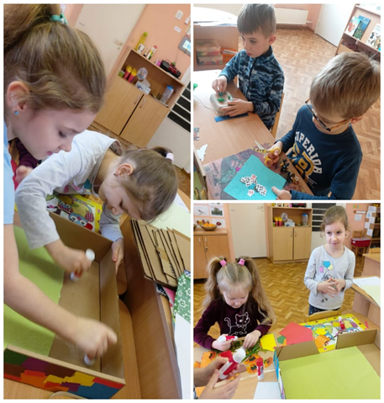
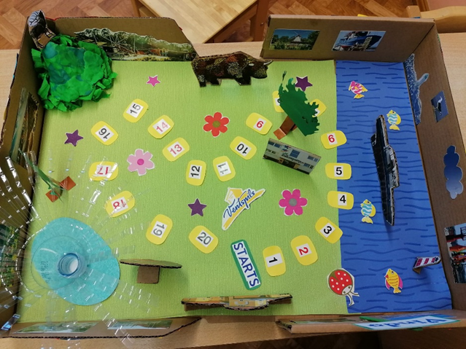
Feedback from participants:
Kindergarten «Little dwarf»: «Thank you for such a nice message in this stressful time! We have wonderful kids and teachers who prepared this! Thank you for the opportunity and we are waiting for new contests!»
Thank you for your attention!

