Slide 1
17 May 2022
Luksia, Nummela
Finland
Riikka Suhonen
Doctoral Researcher
University of Helsinki

Slide 2
GLO-VET project in a nutshell
Duration: 1.9.2020-31.10.2022
Partners: Finland – Luksia; Sweden – Bromangymnasiet; Latvia – Ventspils Tehnikums; Spain – Alén Multimedia
Objectives for:
Teachers: New pedagogical methods, networking, sharing of good practices
Students: Learning global citizenship competence
Schools: Adopting a whole school approach to sustainable development, developing social and environmental responsibility of educational institutions
Activities:
Online workshops on different aspects of sustainability for teachers and students, 12/2020-3/2022
Now: first in-person learning, teaching and training activity week in Finland!

Slide 3
This week
Objective: Understand how UN SDGs (12-17) are linked to vocational fields of study as well as to personal development as a global citizen
Share experiences, good practices and learning from each partner college: How are our VET colleges engaging with these goals locally? What is done in Nordic and Baltic countries, and in our towns to promote the achievement of these goals?
Increase visibility and awareness of UN SDGs locally and within the school
Include more students and teachers from the host institution work towards the project objectives locally
Finalise the project end product

Slide 4
GLO-VET BINGO!
Find a person matching the bingo boxes and write their name on the paper. Start with people you do not know yet.
When you have a completed row: Bingo!
No hurry ☺ Please do ask questions about the person and details of their experiences!

Slide 5
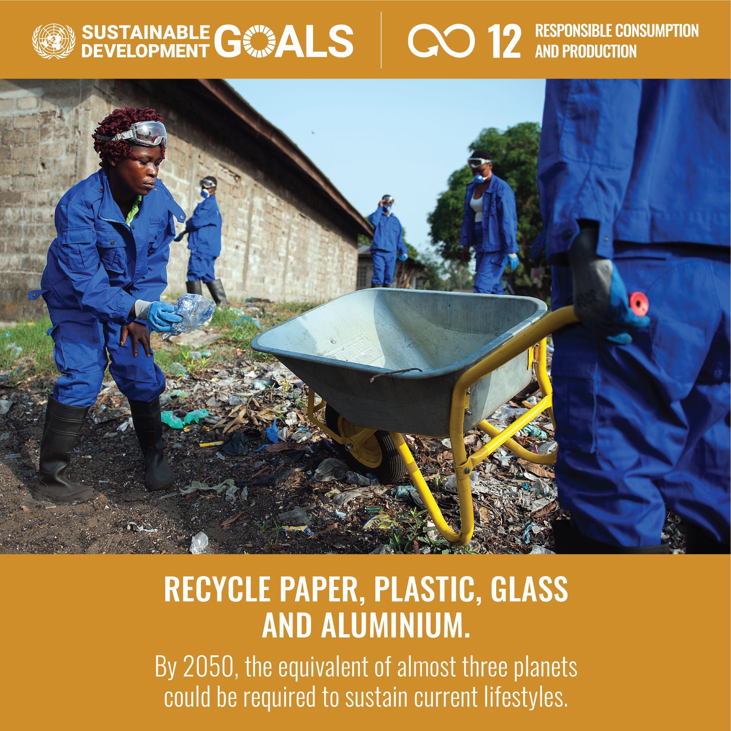
Pre-task; Campus walk; Finnwatch (Tuesday)

Slide 6
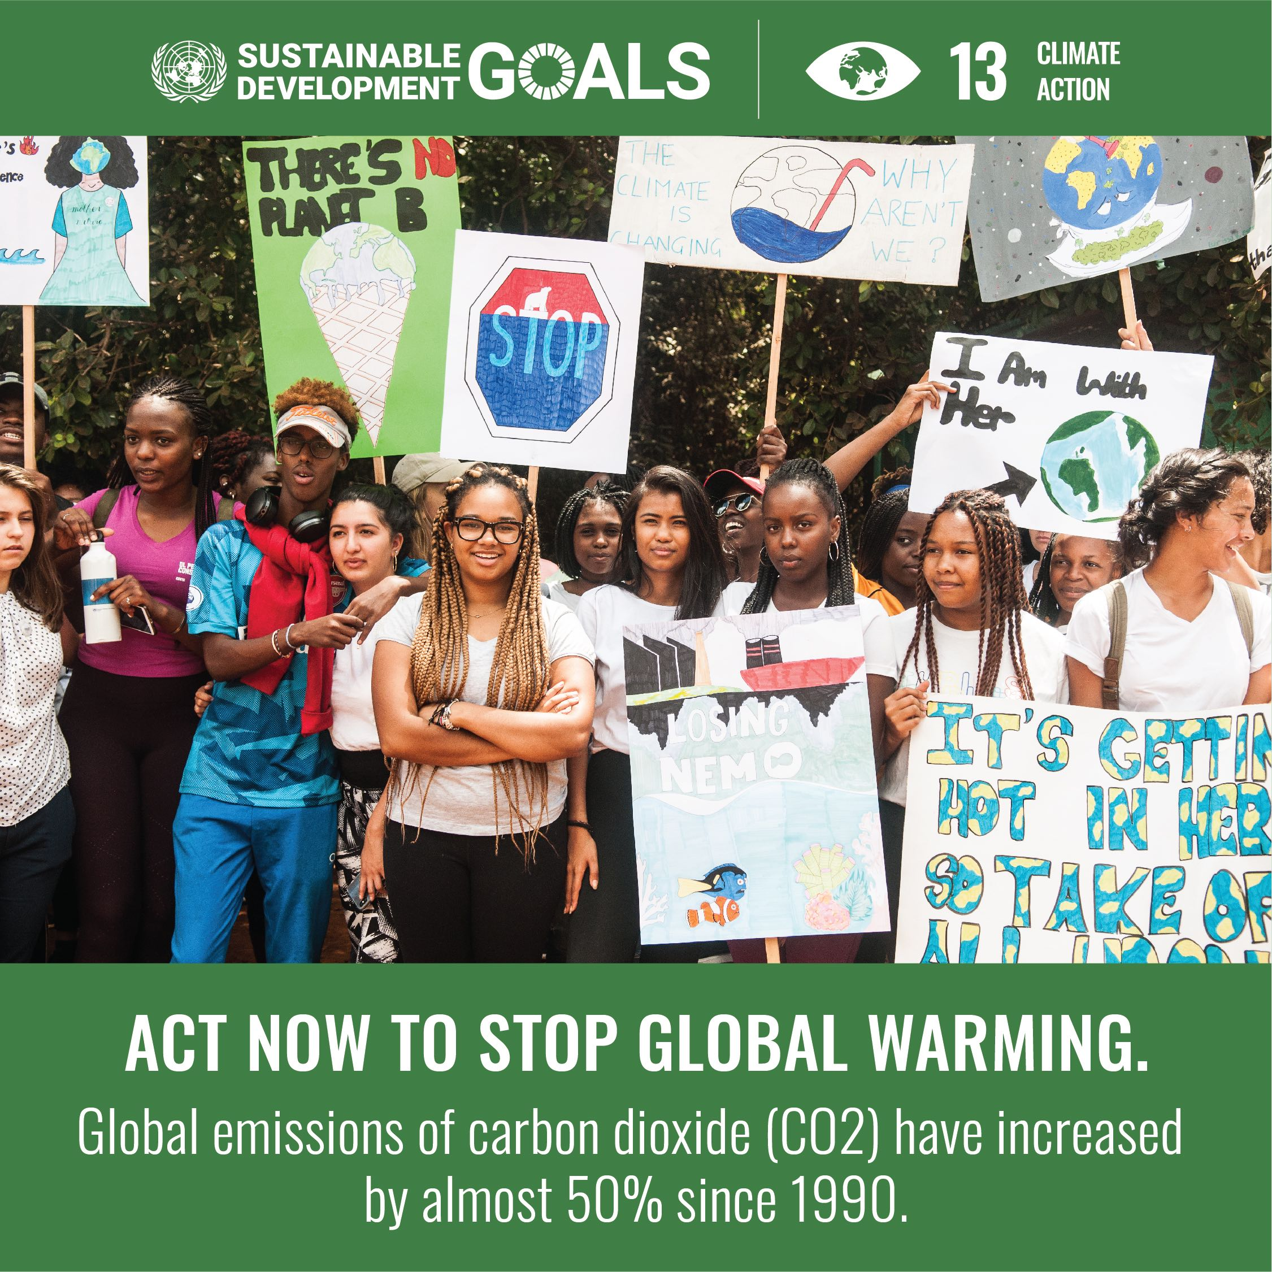
Esa Parkko (Tuesday); Hawkhill visit (Thursday)

Slide 7
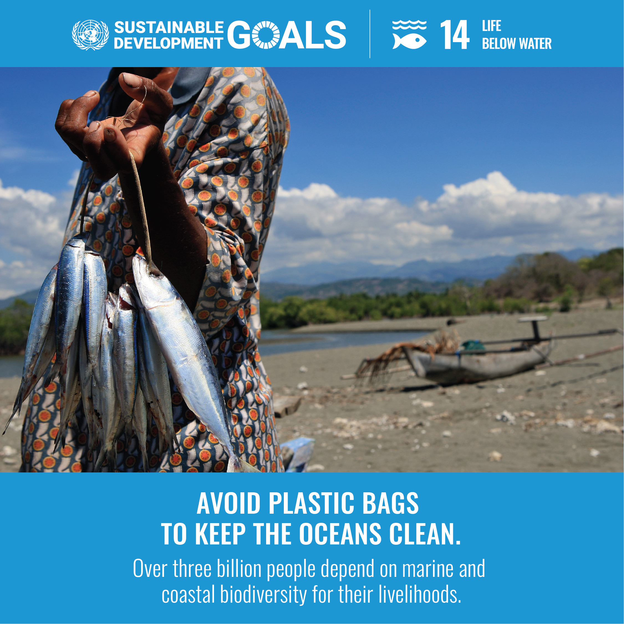
Municipal collaboration project (Thursday)

Slide 8
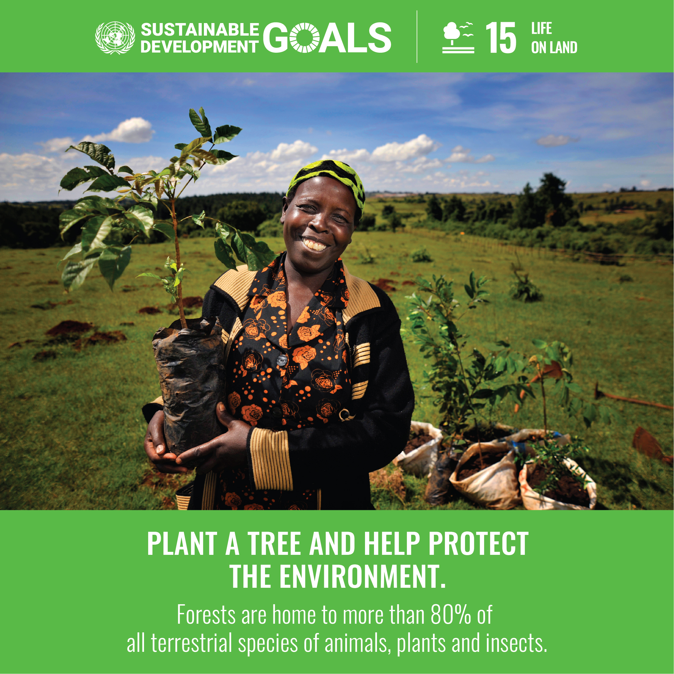
Haltia nature centre (Wednesday)
Notes:
Biodiversity & circular economy: importance of food production, food waste, textiles, industries on biodiversity – what happens in other parts of the world also affect us

Slide 9
Luksia’s equality & non-discrimination plan; Finnwatch (Tuesday)
Notes:
Also March online workshop

Slide 10
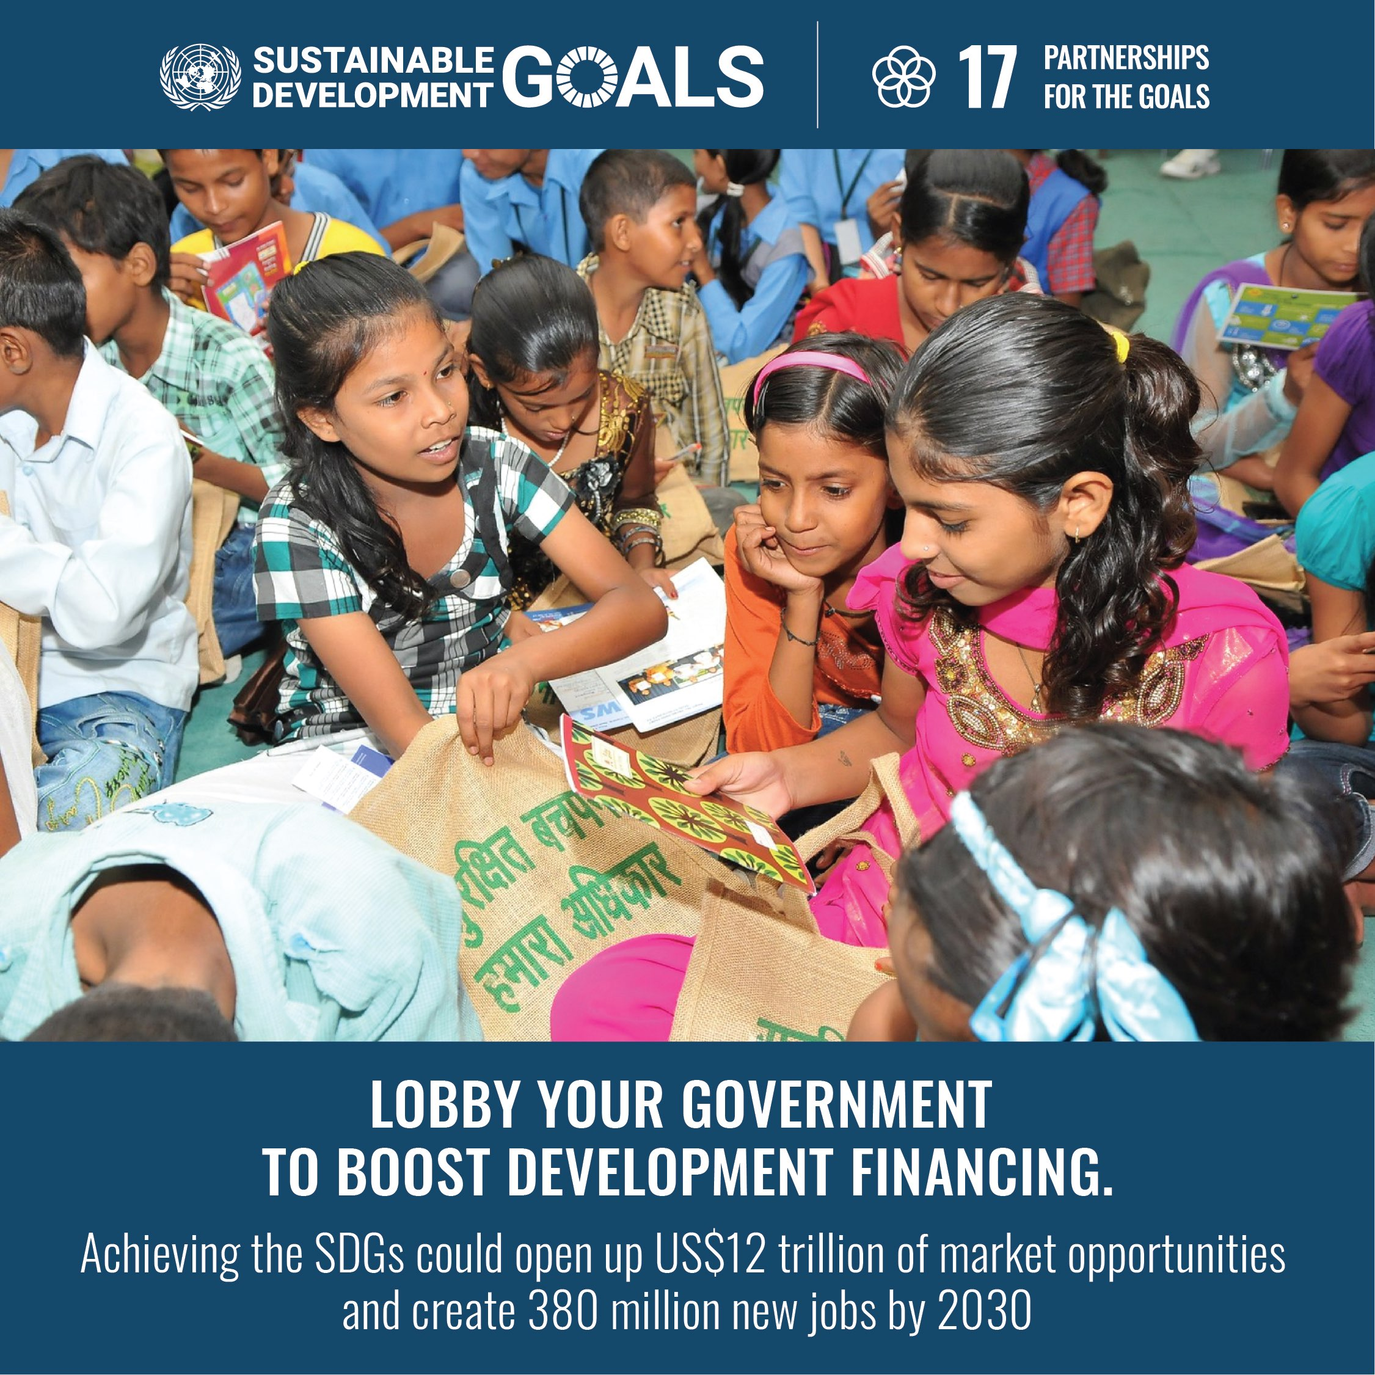

Slide 11
HEAD, HEART & HANDS
What & why Motivation & values Action
Notes:
These are important for sustainability education and global citizenship education!

Slide 12
HEAD
Knowing facts
How decision-making works?
How can I influence or engage with decision-making locally, nationally, globally?
How people are already working to combat climate change or to promote social justice and human rights?
Notes:
knowing the facts
how decision-making works and how can I influence or engage
how people are already working to combat climate change or to promote social justice and human rights

Slide 13
HEART
Values: what matters to me?
Emotions: may awaken us to see how things really are and drive towards action
Feeling anxious, overwhelmed or guilty are normal reactions to the wicked global problems of today; necessary emotional work to be able to think critically & differently about our world
Notes:
feeling anxious or overwhelmed is a normal reaction to the wicked problems of today
emotions may also awaken us to see the how things really are, and drive towards action
The collective “Gesturing towards decolonial futures” has raised issues about learning to give palliative care to our current, destructive ways of living. Mourning for the loss of the world as we know is painful, and includes feelings of guilt, anxiety and sadness. This emotional work is necessary for us to be able to think critically “in a different way” and to give birth to new worlds.

Slide 14
HANDS
Action: creates hope and also knowledge (learning by doing)
Individual choices related to consumption, food, energy, transport
Societal choices and community level actions (municipalities, schools, hobbies, workplaces, families)
Pressure for bigger change towards those in decisionmaking positions
Notes:
creates hope; doing together with others is more fun and has more impact
action creates knowledge (learning by doing), but critical reflection and questioning, evaluation is needed
individual acts are possible in everyday life: e.g. choices related to consumption, food, energy, transport (within income level)
however, solving the climate crisis is not an individual problem – it is a societal problem
community level actions (municipalities, schools, hobbies, workplaces, families, houses)
The pressure for bigger change needs to be directed to those making decisions in politics and in companies

Slide 15
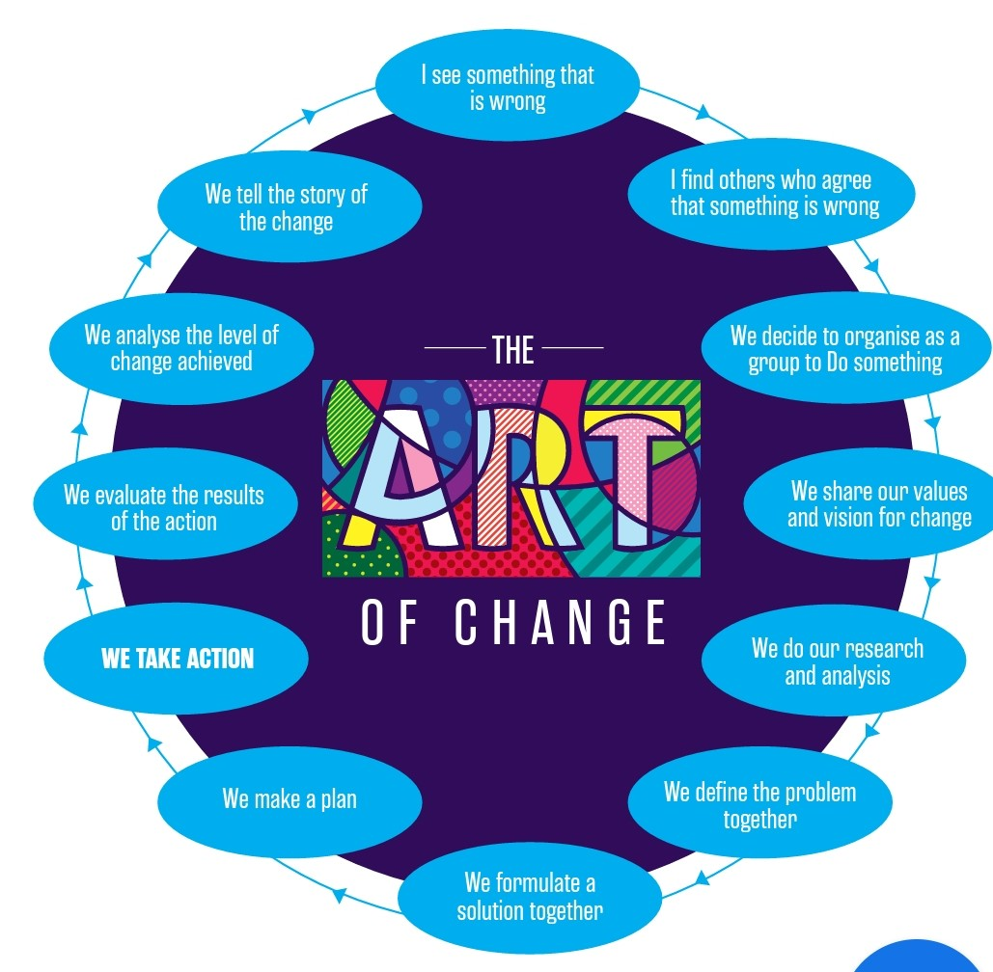
Source: National Youth Council of Ireland. (2019). Activism, the SDGs and Youth. Development Education. Global Citizenship Education. Resource pack. https://www.youth.ie/wp-content/uploads/2019/05/Activism_the_SDGs_and_Youth.pdf
Working together is fun and has bigger impact
Sharing ideas
Many perspectives
Supporting each other
Notes:
often vocational students are not somehow given the space or expected to question things, to ask questions, to promote change in their workplaces and societies
we hope that through participating in this week you gain knowledge, motivation, perhaps even more interest towards the different aspects of sustainability
understanding how much is already being done, to instill hope
using the UN SDG framework as a starting point

Slide 16
ENERGY, TRANSPORT, FOOD, SPEAKING UP
https://www.un.org/en/actnow
Notes:
Energy and transport
Food matters
Speak up

Slide 17
FIND YOUR OWN WAY TO ACT AS A GLOBAL CITIZEN
Talk to your own family or peers
Find other like-minded people willing to work together
Many environmental or human rights NGOs and activists exist already!
-> Follow them on social media
-> Donate or volunteer your time
Speak up!
Participate in demonstrations or share your thoughts to decisionmakers in other ways, e.g. sending an email or meeting them in election events to ask questions
Gather names for citizen initiatives
Appeal to decisionmakers in your school, your neighbourhood or other social community (e.g. hobby, workplace)
Make your views known through ”artivism”: write a song, make a painting…
Notes:
Appeal to world leaders, urge your city, your bank and your employer to take urgent action toward net-zero emissions.
finding your own way to act is important
during this week, also trying to demonstrate various ways in which individuals and communities can act: municipal level, in companies and businesses, in schools

Slide 18
Your expectations?
Take 3 minutes to write down what kind of expectations you have for the next three days.
Head (content, knowledge)
Heart (emotions, values)
Hands (how we work as a group)?
Then share your expectations with the person next to you.
Notes:
Coming back to the expectations at the end of the week on Friday morning

Slide 20
LET’S START WITH THE HEART!
1. Write down 10 most important values to you
2. Erase 5 less important of them
3. Erase 2 more
Which 3 values are left?
Compare with the person next to you
How has your life / choices been guided by these values? Give examples.
What do you need to stop/start doing in order to live closer to your values?
Courage Compassion Caring
Justice Friendship Honesty Freedom Curiosity
Imagination Equality Humour
Wisdom Success Pleasure
Cooperation Security Tradition
Respect Power Protection of nature
Notes:
From Sweden workshops for teachers with Globala Skolan
Companies and workplaces have also values: e.g. Luksia: openness, professionalism, based on the customer’s needs; University of Helsinki: freedom, truth, Bildung
How do your personal core values match with those of the society or your potential workplace?

Slide 21
PRE-TASK: SHIRTS IN YOUR CLOSET
Investigate your own clothes closet:
How many pieces of different shirts do you have?
Which ones do you wear a lot and for a long time? Why?
How many of the shirts do not use that much? Why?
Why is it important to consider how long you use certain garment, or in what kind of circumstances it has been produced?
Share your thoughts on these questions in groups of 4
10 minutes!

Slide 22
CORPORATE SOCIAL & ENVIRONMENTAL RESPONSIBILITY
Recordings of the NGO Finnwatch: recap
Construction sector in Finland
Fast fashion / Textile industry globally
What kind of examples of ethical questions and global justice can you think of in workplaces? (production chains, working conditions etc)
How can you identify possible labour exploitation or human rights violations at your workplace? What can you do about them?
How will transition to low-carbon economy impact your work? How to make sure that this transition is "just" for different groups of people?

Slide 24
ENTANGLEMENT WALK
30 minutes, everyone to do individually in the nature using their imagination.
1. PRESENT: Connecting to nature in 2022.
Explore your environment like a playful, 2-year old toddler. Try to connect with everything living and non-living and listen to what kind of stories they might be telling. Pause to touch or smell moss on a rock, for example. Use all your senses!
2. PAST: Have an imaginary discussion with your ancestor from 100 years ago, in 1922.
What stories or guidance would they have for you? What was life back then? How did your ancestor see the future? What would you tell them of today and your life?
3. FUTURE: Walk with your descendant 100 years from now, in 2122.
Listen to your descendant’s advice on how we could improve their well-being. What should we do, say, think – or stop doing, saying or thinking? How is the world like in 2122?

Slide 25
WRAP-UP: WE HAVE A DREAM…
30 minutes in groups of 4 people:
1. Go back to your values, the SDGs 12-17 & today’s programme
2. Think of issues that are meaningful to you and have an impact on the world right now.
-> 3 minutes each individually, use post its
3. Share your thoughts with the group and select one issue together.
-> Which SDGs is it related to, if any? Why is this issue important?
4. Formulate the issue into an objective: “We have a dream…”
5. What possible actions could be taken on the local level to make that dream come true? Can you challenge someone, other students or teachers in your school to do something about it? What obstacles stand in its way?
6. Write “We have a dream…” followed by your issue and possible actions on a cardboard (you can also use laptop or mobile for making a poster).
Notes:
Brainstorm with the group all of the issues that they can name that are having an impact on the world right now especially in relation to SDGs 12-17. Encourage everyone to offer something, one word answers are enough.

